Slide 1




Hjernen i ambulansen
Maren Ranhoff Hov
Førsteamanuensis, Bachelor i prehospitalt arbeid, OsloMet
Lege, Nevrologisk avdeling, Oslo Universitetssykehus
Seniorforsker, Stiftelsen Norsk Luftambulanse

Slide 2
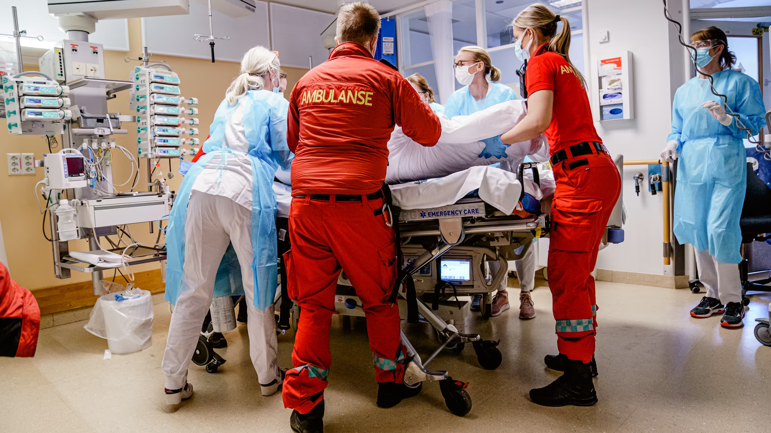

Slide 3
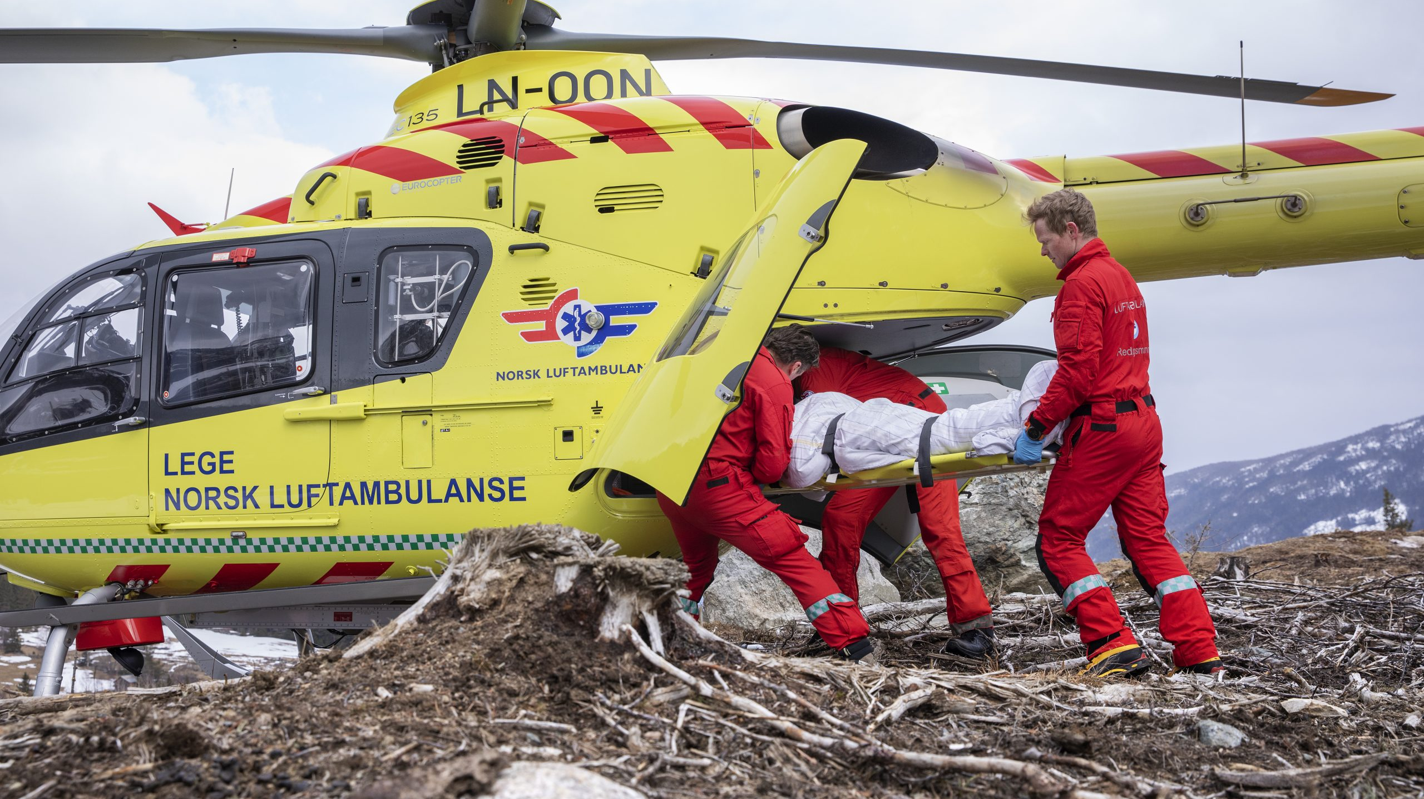

Slide 4
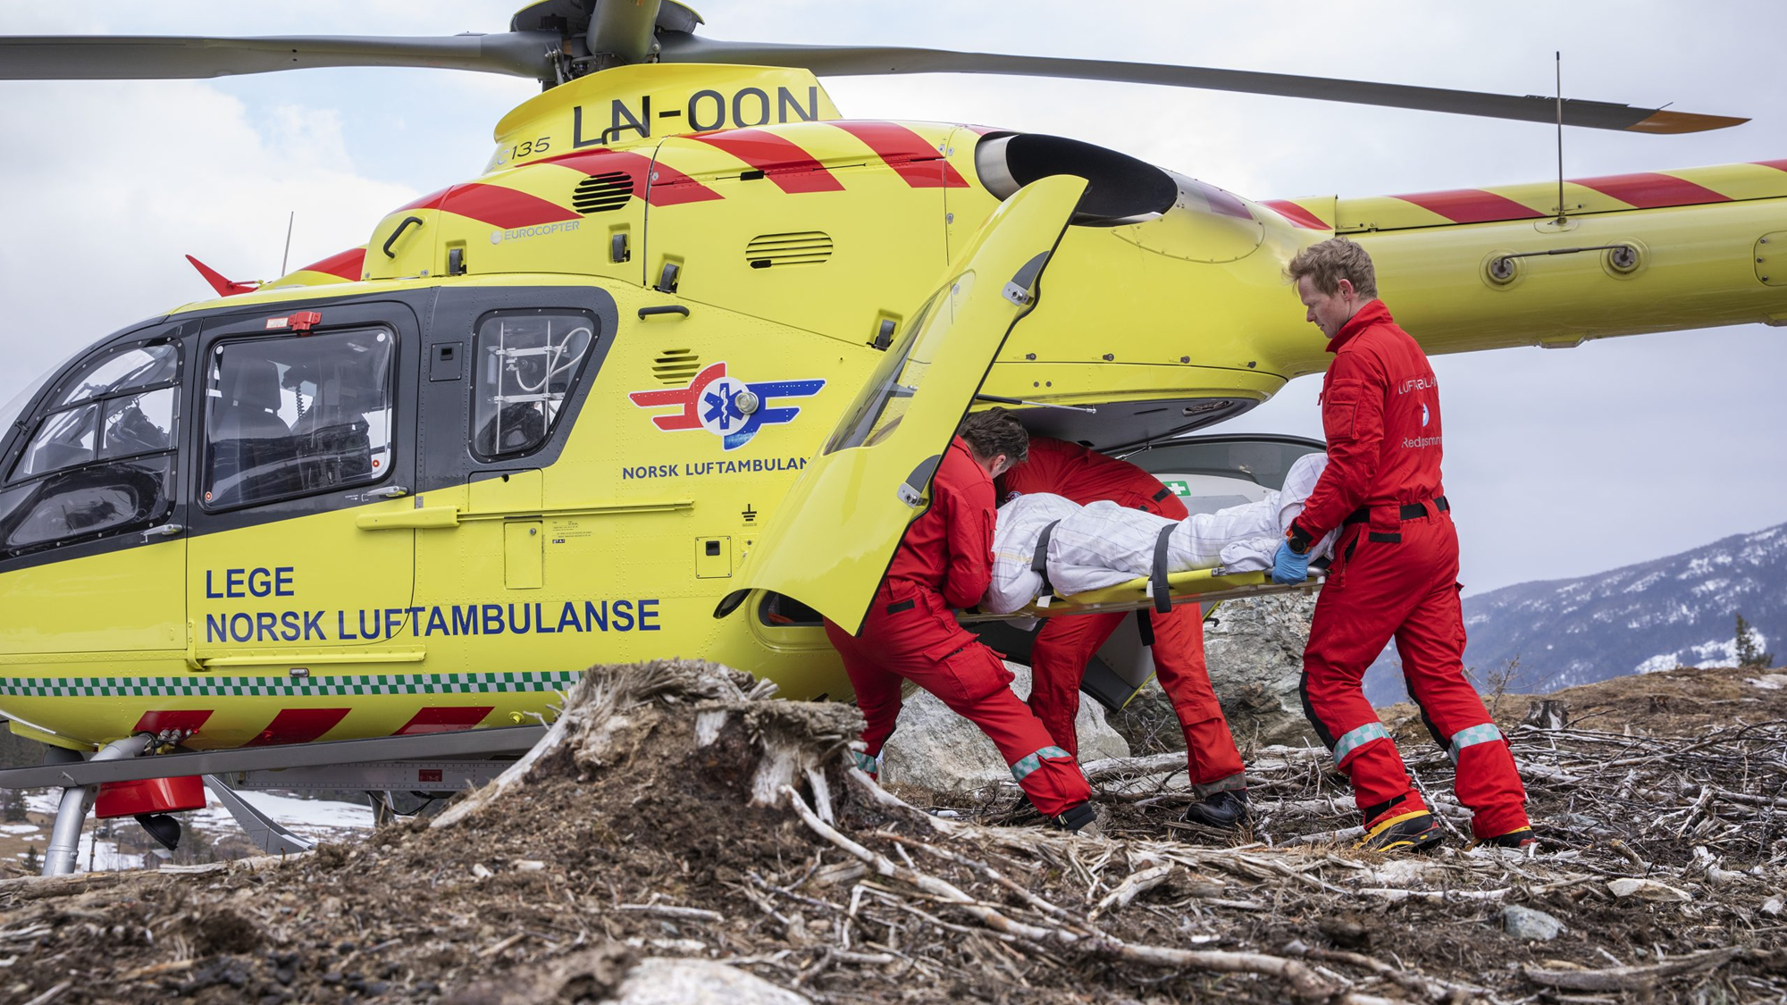
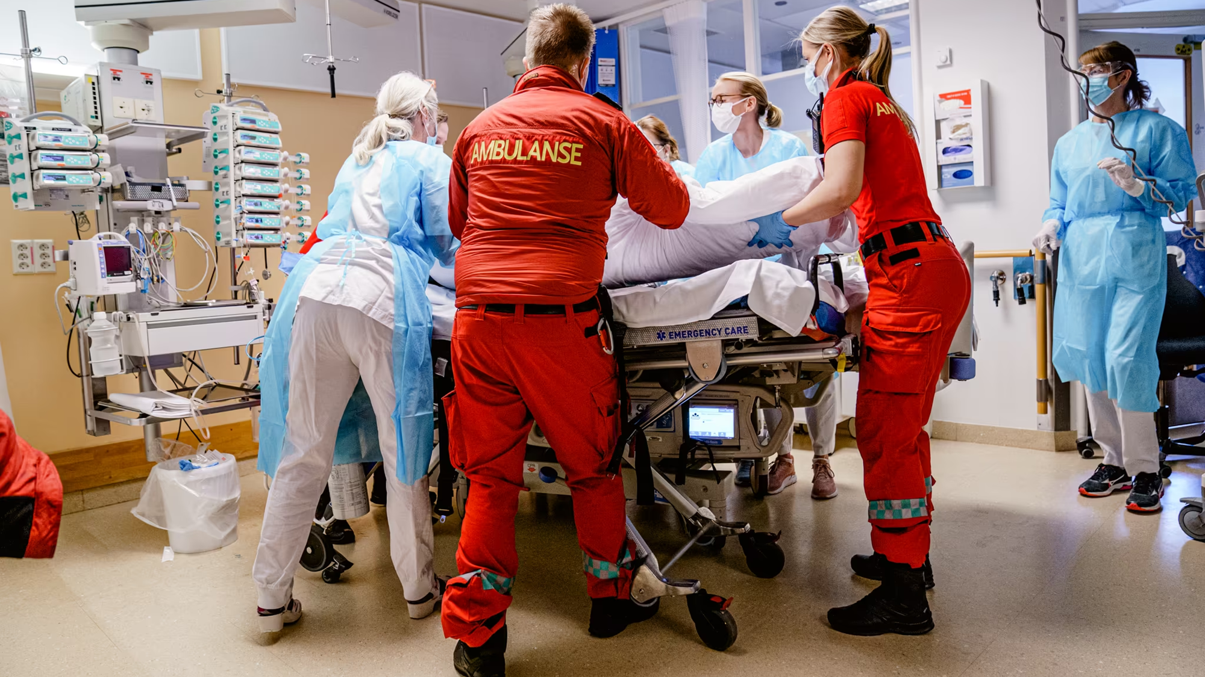
KOMPETANSE
KOMMUNIKASJON

Slide 5


Slide 6
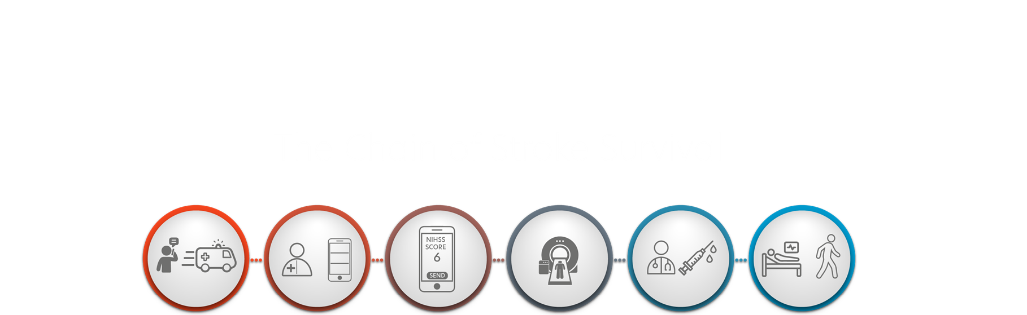

Slide 7
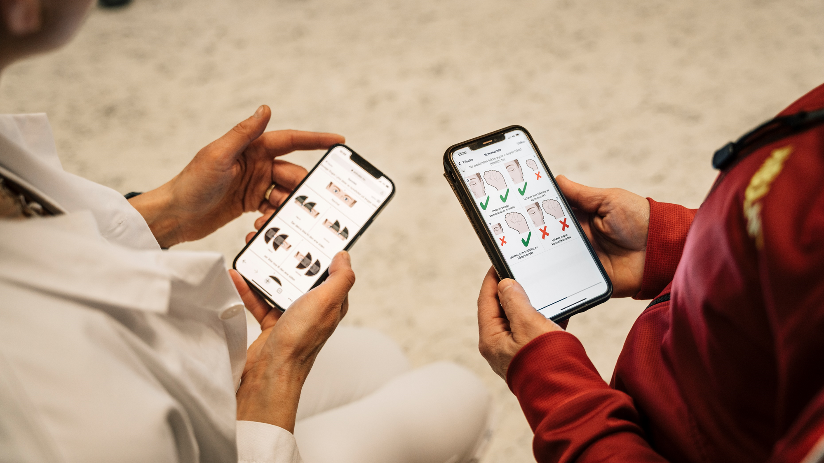

App-basert diagnostikk av slagpasienter for ambulansetjenesten

Slide 8
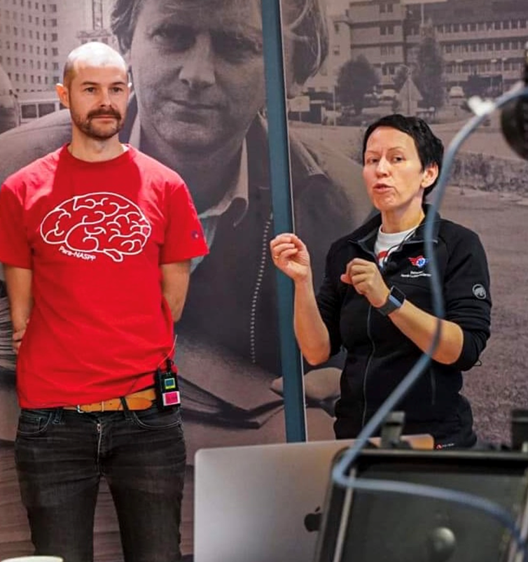
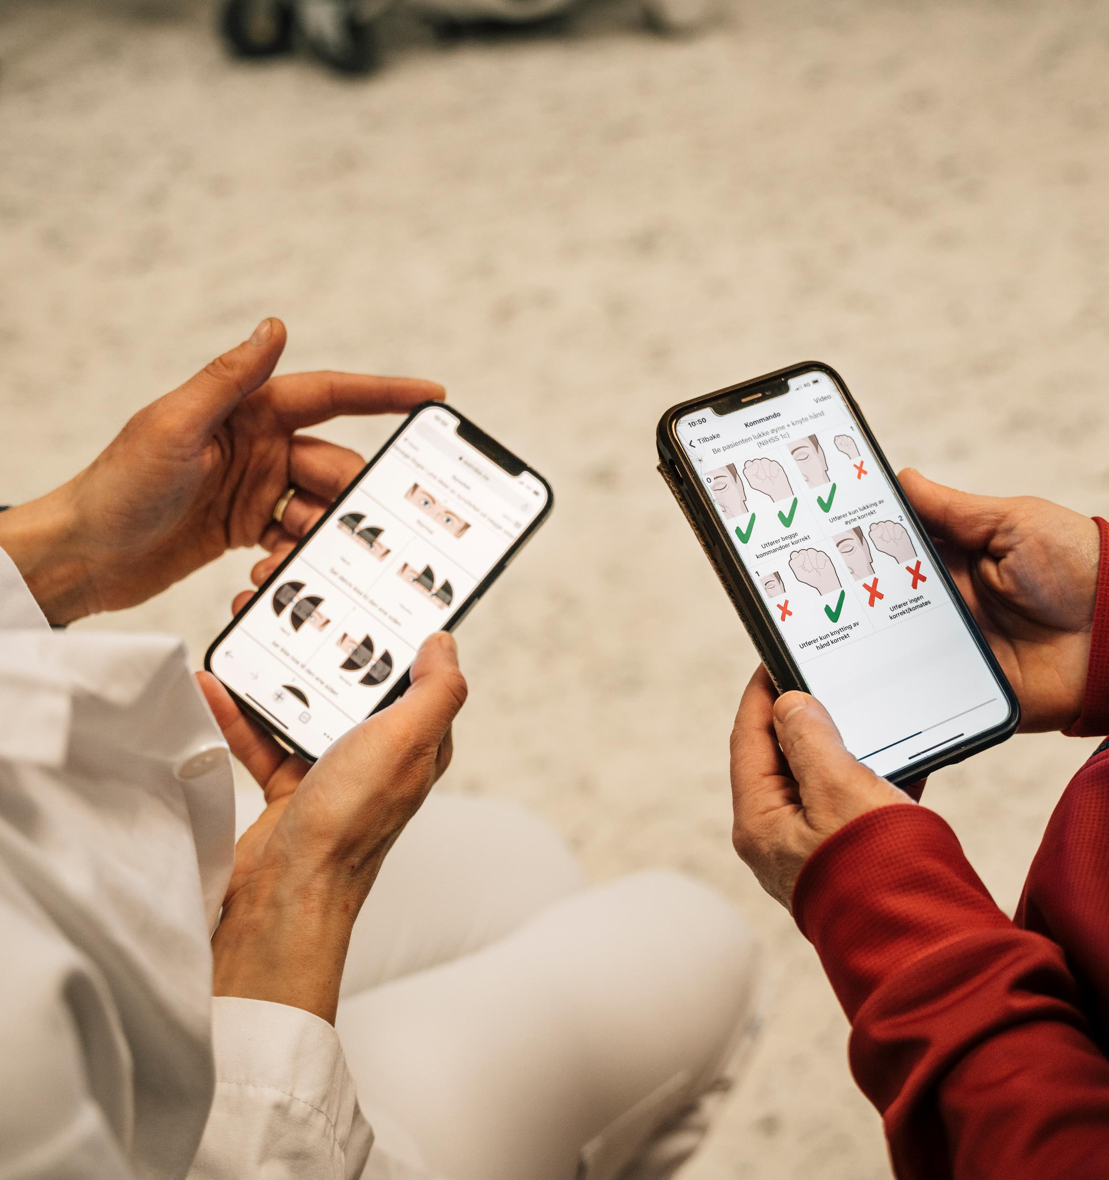
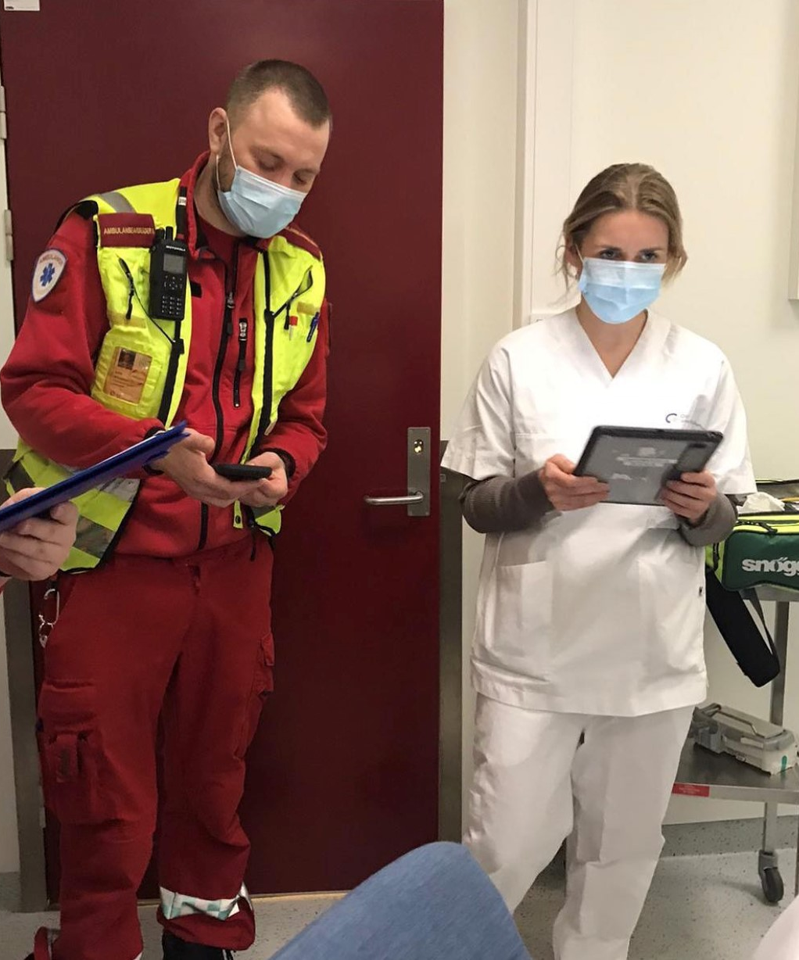
1. Opplæring
2. Mobilapp
3. Kommunikasjon
Guterud et al. Trials, 2022
Notes:
Helge
Our intervention consisted of three parts:
1: Teaching paramedics about stroke and practising the NIH stroke scale, in a specifically designed digital learning program.
2: The NIH stroke scale made into a mobile application to guide paramedics using pictograms and ensuring registration of symptom onset and anti-thrombotic medication.
3: The application transferred the results of the prehospital examination to the on-call stroke physician, thereby standardizing communication and providing a common language between pre and in-hospital stroke services.
Mona
We aimed to include 808 patients. Inclusion criteria was when a paramedic suspected
acute stroke in individuals over 18 years. The patients included for analysis were patients accepted
by the stroke team at Oslo University Hospital. Our primary endpoint was positive predictive
value of a final diagnosis of stroke. and that this number would be significantly higher in the intervention group compared to the control group.
Secondary endpoints were, among others, different time variables and 90 day functional outcome.
And here are our results!

Slide 9
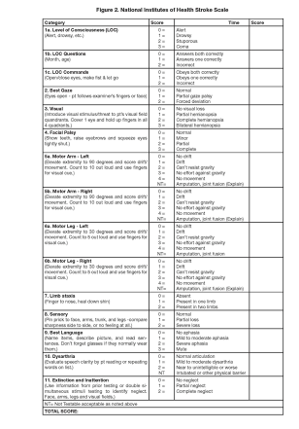
Det tradisjonelle NIHSS skjemaet

Slide 10
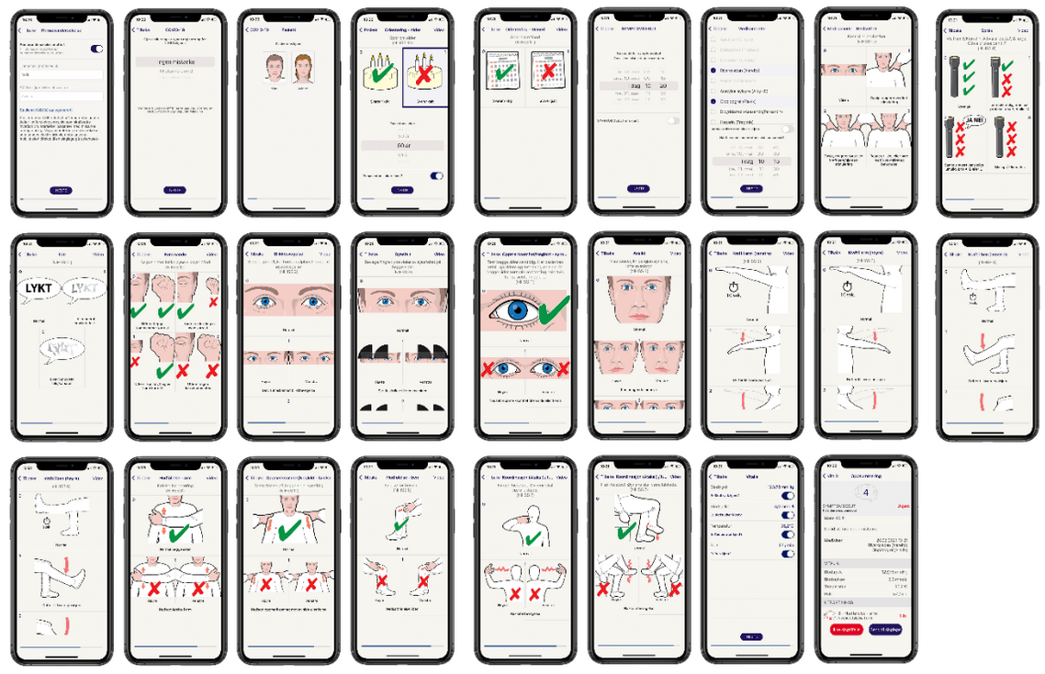
Notes:
Consist of other projects such as
Mobile stroke unit
Ultra early tombolysis (treat NASPP)
NIHSS performed by paramedics (ParaNASPP) e- learing and the eStroke application for scoring and communicating with the stroke physician
All projects aim to encance early detection and treatment of acute stroke
So we took this: -> into this

Slide 11
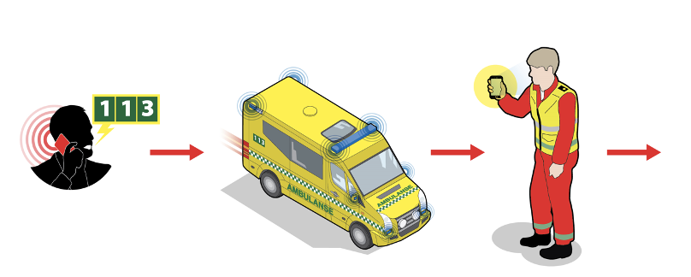
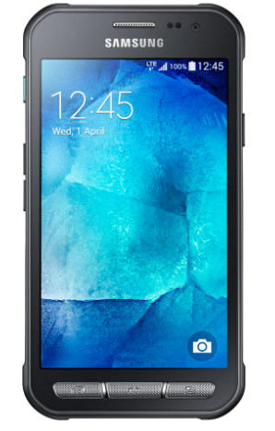
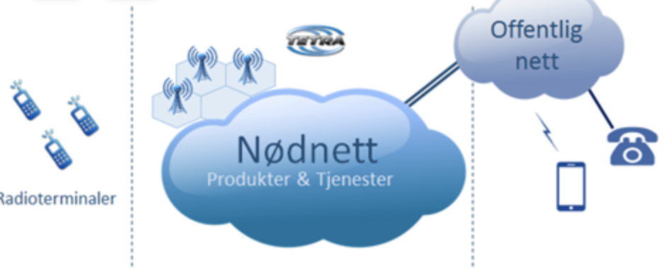
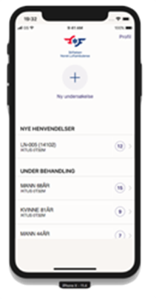
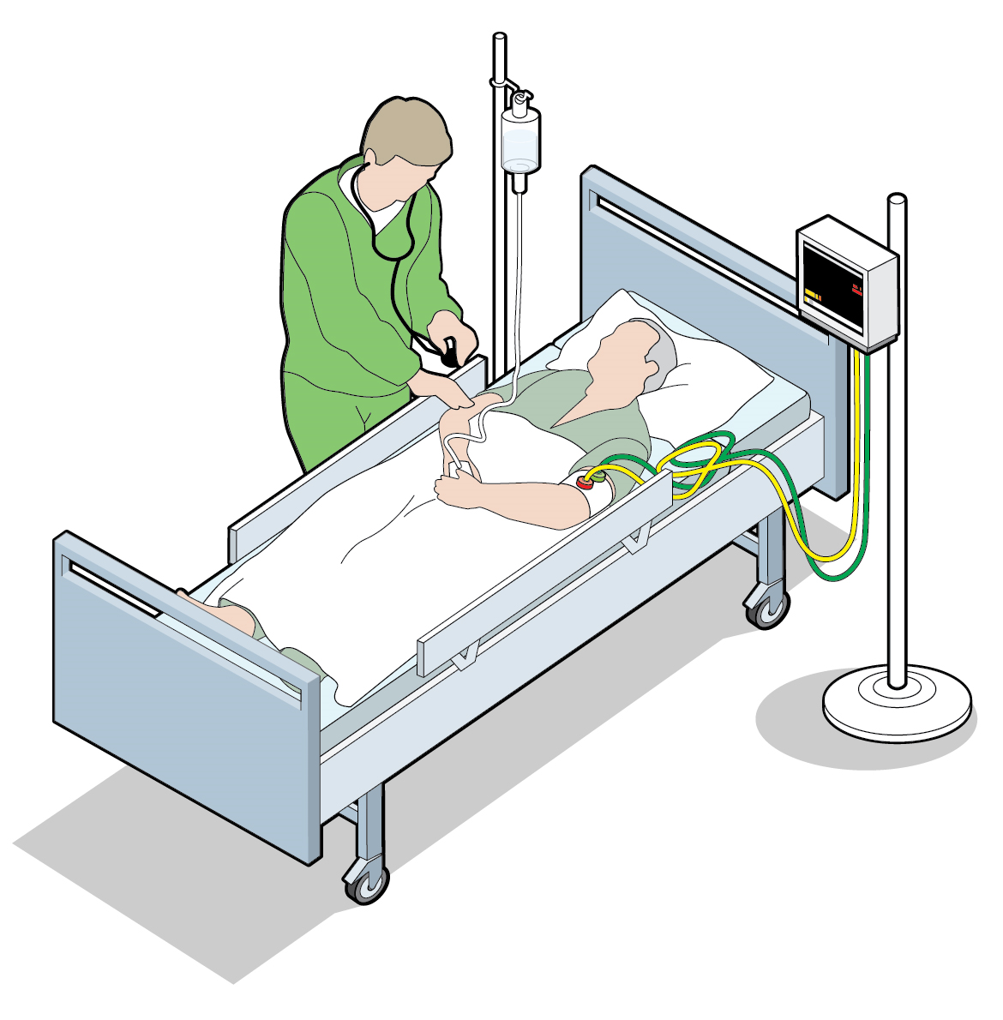
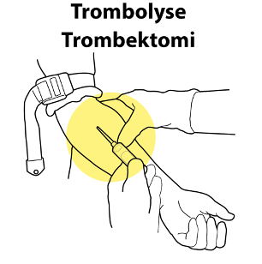
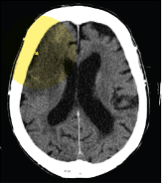
Kontakt AMK
Ambulanse rykker ut
Ved mistanke om slag vil ambulansepersonell gjennomfører NIHSS
Undersøkelse loggføres ambulanse vakttelefon som overfører NIHSS til DIPS
Konferansesamtale mellom AMB og nevrolog /LIS 1 / LIS 2 av AMK Bodø i nødnett
Pasienten legges inn på medisinsk /nevrologisk observasjonspost eller sengepost
Behandlingsbeslutning etter standard protokoll
Ankomst sykehus og tas imot som slagalarm
Avklares i konferansen om slagalarm og destinasjon
Notes:
EPJ – tøffpad = robust nettbrett. Flere og flere i Norge EPJ. Leverandør elektroniske løsning Csam.

Slide 12

12 weeks | 12 weeks | 12 weeks | 12 weeks | 12 weeks | 12 weeks
Cluster 1-5 Control |  |  |  |  | Cluster 5 Intervention
 |  |  |  | Cluster 4 Intervention
 |  |  | Cluster 3 Intervention
 |  | Cluster 2 Intervention
 | Cluster 1 Intervention
Metode
Stepped Wedge Cluster Randomized Trial
Notes:
Mona
The ParaNASPP trial was a prehospital stepped wedge RCT that took place in Oslo, Norway from June 2019 to July 2021, included a 7 month break due to the covid-19 pandemic.
5 ambulance stations, each a designated cluster, participated in the trial. Every cluster started registering patients with suspected stroke in the control group, then one cluster at a time received the ParaNASPP training and crossed over to the intervention group. When the trial finished, all clusters were in intervention, and we had trained 270 paramedics. The control group followed standard acute stroke procedure, which consists of an examination using Face Arm Speech Test and then a telephone conference with the on-call stroke physician before arrival at the hospital.

Slide 13
Baseline data | Intervention | Control
Included for analysis | 447 | 354
Characteristics
Sex Women Men | 201 (45%) 246 (55%) | 179 (51%) 175 (49%)
Age, years Mean (SD) | 70.8 (16.9) | 71.4 (15.9)
Medical history, number (%) Atrial fibrillation Hypertension Hypercholesterolemia Diabetes TIA Ischemic stroke Coronary disease Intracerebral haemorrhage Anticoagulant use Antiplatelet use Antihypertensive use Statin use Currently smoking Living alone | 83 (18.5%) 226 (50.6%) 169 37.8%) 64 (14.3%) 38 (8.5%) 82 (18.3%) 46 (10.3%) 13 (2.9%) 88 (19.7%) 135 (30.2%) 199 (44.5%) 159 (35.6%) 57 (12.8% 163 (36.5%) | 67 (18.9%) 167 (47.2%) 137 38.7%) 41 (11.6%) 34 (9.6%) 78 (22.0%) 55 (15.4%) 7 (2.0%) 72 (20.3% 110 (31.1%) 142 (40.1%) 130 (36.7%) 56 (15.8%) 131 (37.0%)
Prestroke mRS , number (%) mRS 0-2 mRS 3-5 | 360 (83.1%) 73 (16.9%) | 280 (81.2%) 65 (18.8%)
Resultater
Notes:
Helge
The table behind us displays our baseline data. 801 patients were included for analysis. 447 in the intervention group and 354 in the control group. The mean age was 71 and 48% were women. The groups were similar in regard to past medical history and premorbid mRS.

Slide 14







eSTROKE
e-læring
digital undervisning
eSTROKE app
felles språk
utvikling
database
forskning

Slide 15
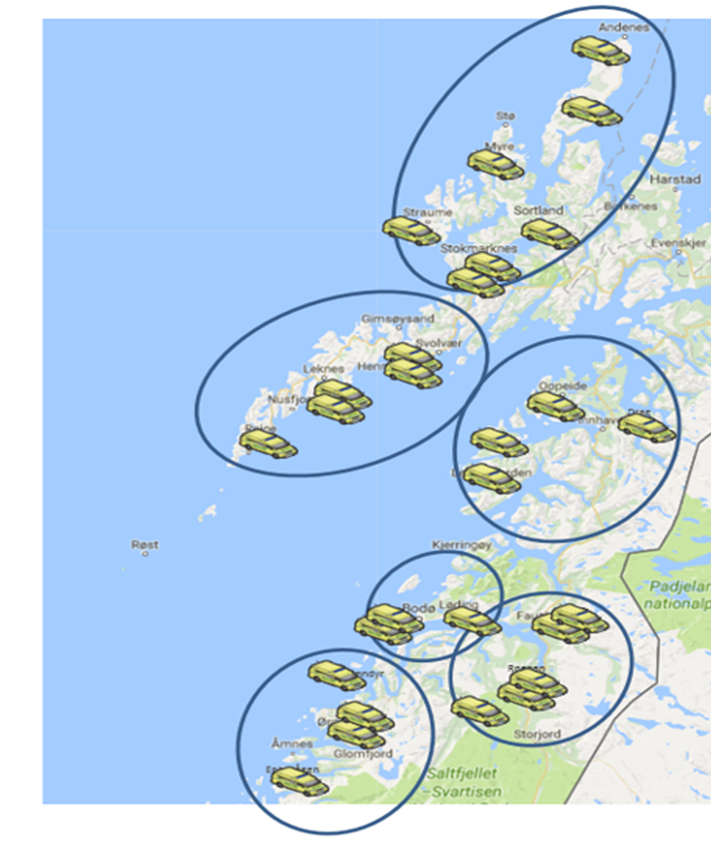
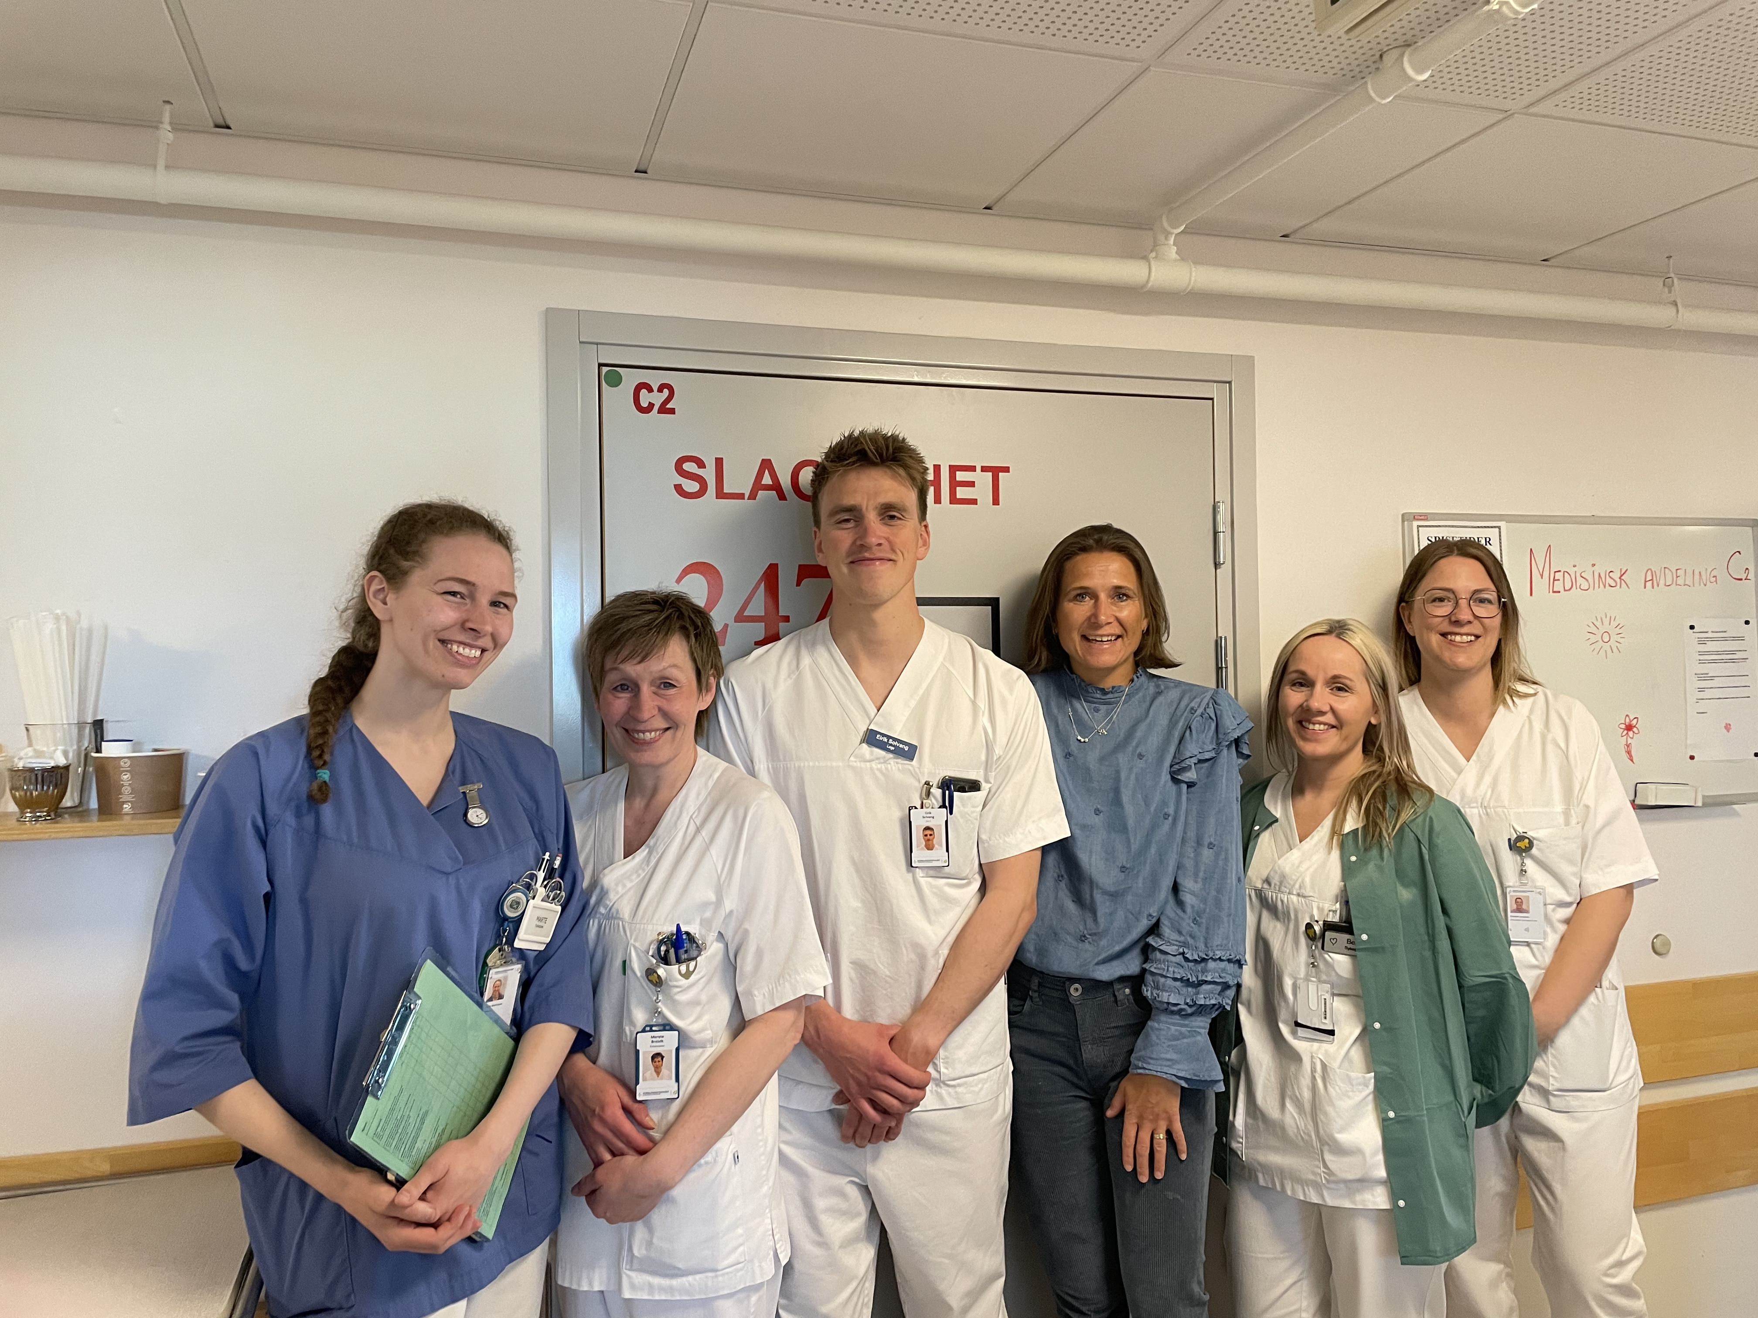

Slide 16

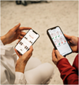


Slide 17
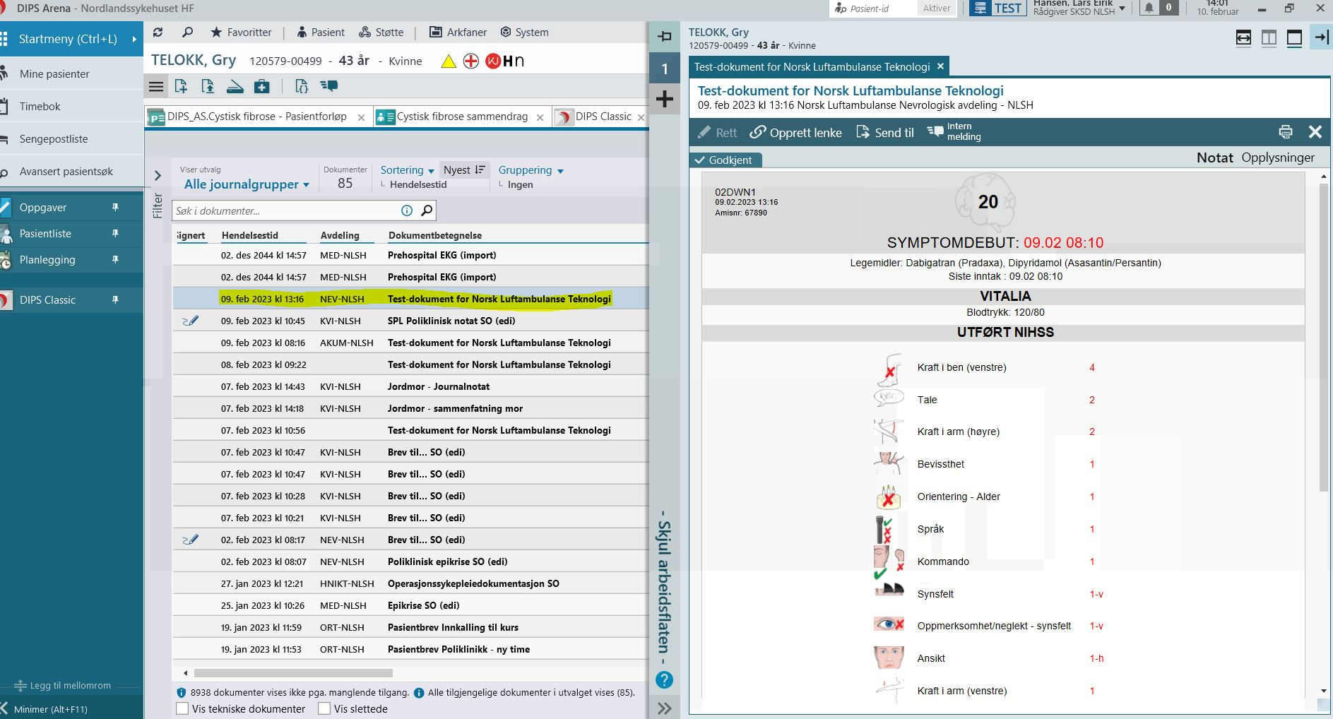

Slide 18



eSTROKE database
Prehospitale kvalitetsindikatorer
Resurssbruk
Behov for forskning og utvikling

Slide 19
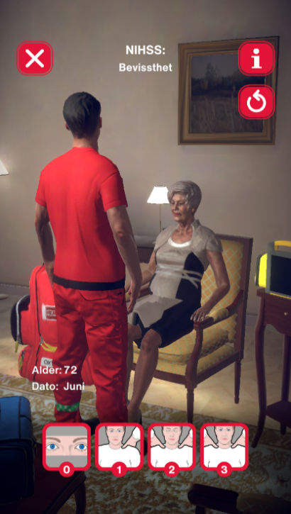
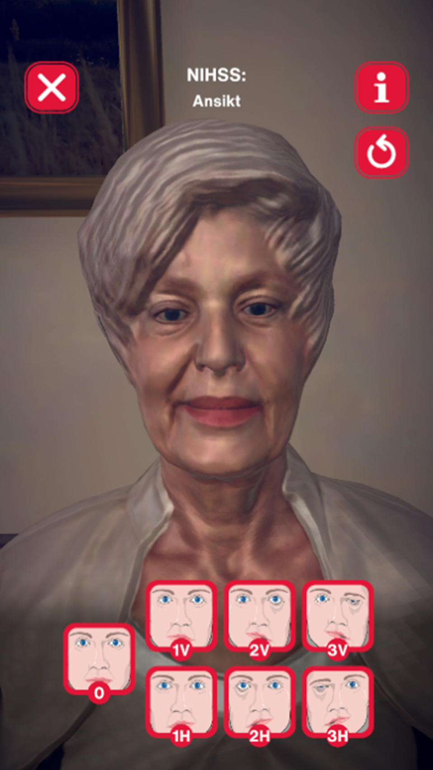
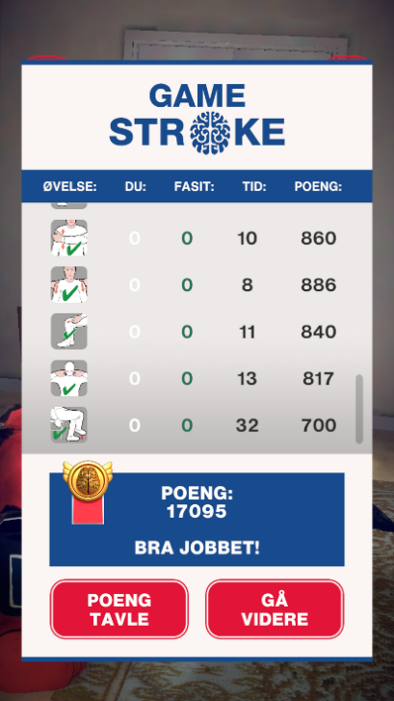
Notes:
Roberta and Gamestroke is Newest addition to the NASPP family
The game and interface is based on eStroke
Using the same pictograms
Gamification Became a MeSH term in 2022
It is defined as the ‘application of game mechanics to non-game contexts to engage audiences and to inject some entertainment into mundane activities besides generating motivational and cognitive benefits’
And why did we do this? Well..

Slide 20
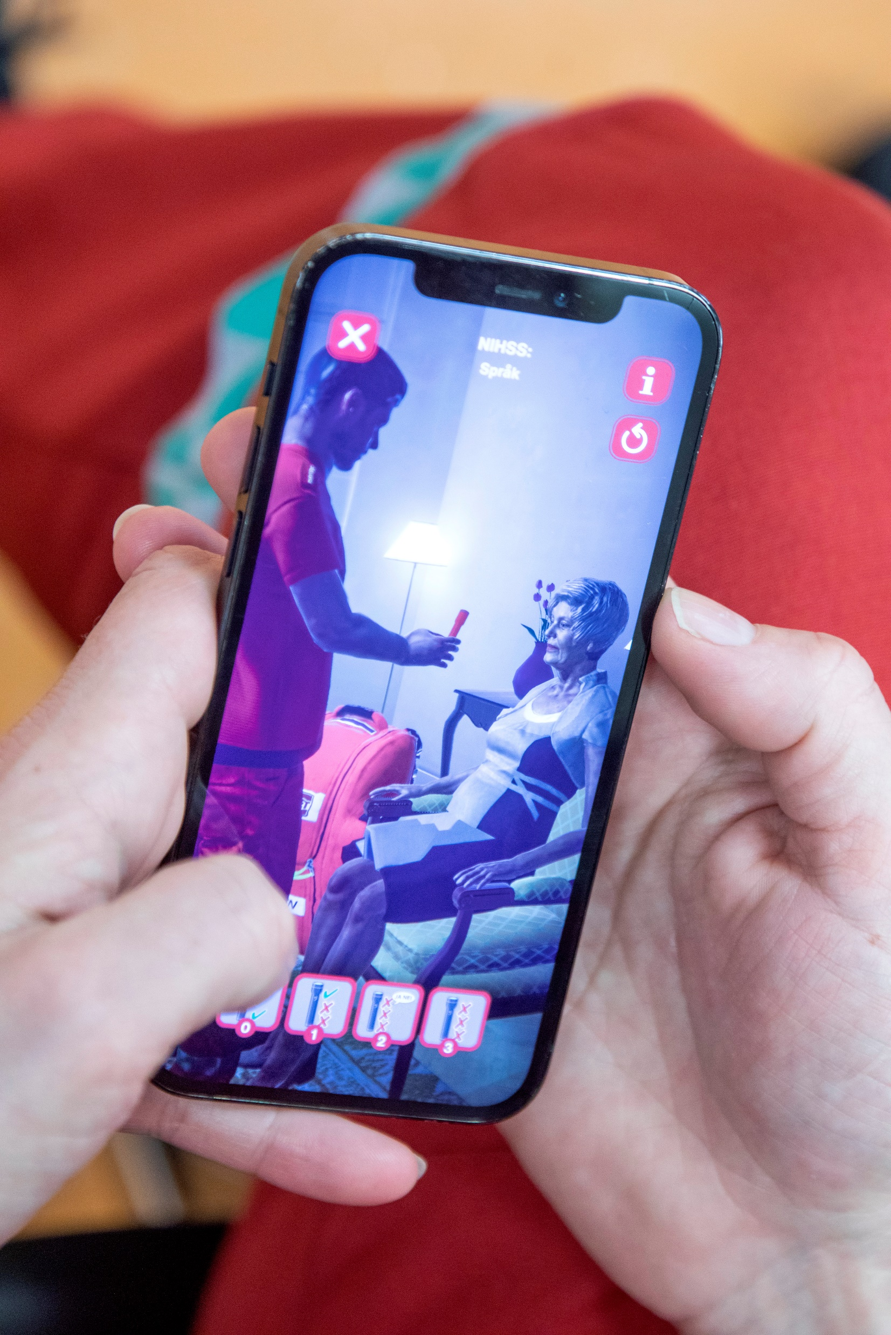
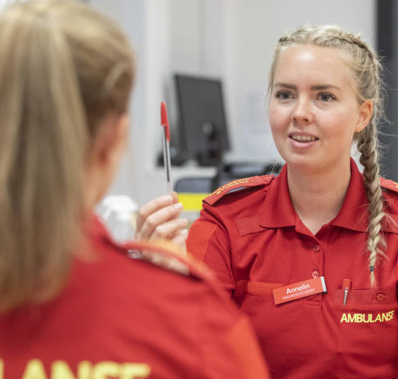
Notes:
Game simulation vs. standard in-person training

Slide 21
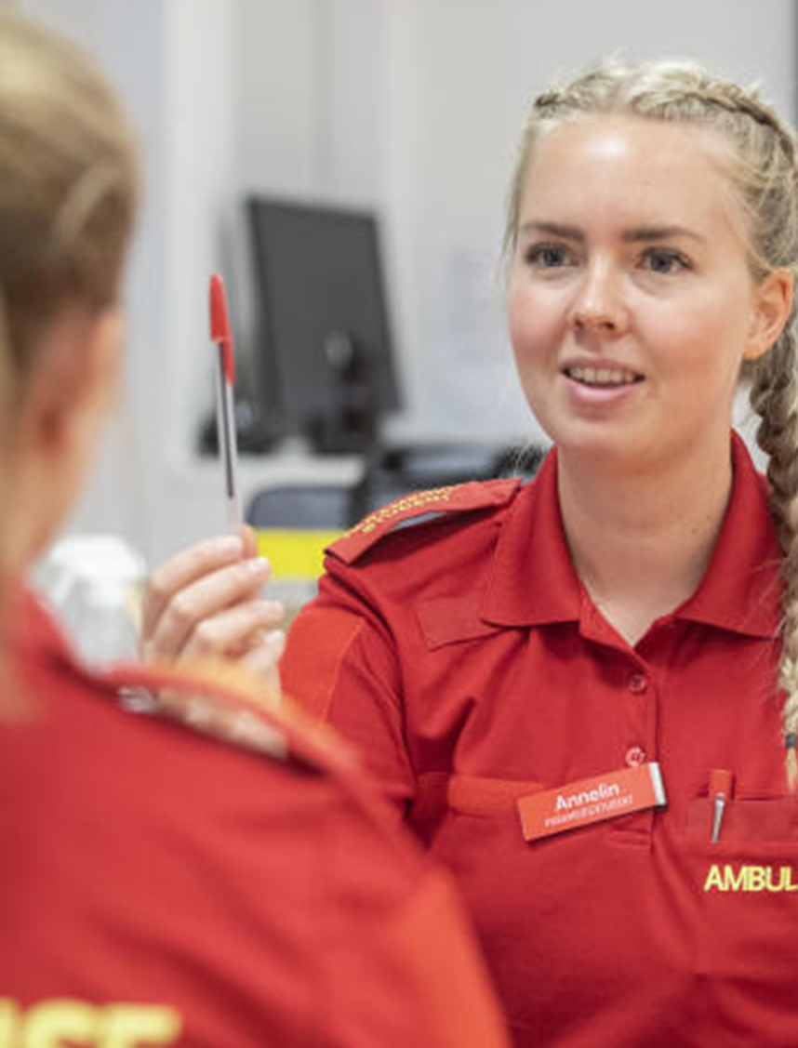
 | GameStroke | Tradisjonell simulering
Antall studenter | 23 | 27
Total antall simuleringer | 333 | 36
Total tidsbruk på simulering | 16.3h | 2.4h
Gj.snitts tid på simulering | 42:36min (SD:36) | 9:28min (SD:8)
Gj.snit antall simuelringer | 14.4 (SD: 13) | 2.5 (SD:1)
Gj.snitt tidsbruk per simulering | 2:57min | 3:50 min
Alle resultater er signifikante
Harring, A et al. Advances in Simulation, 2023.

Slide 22
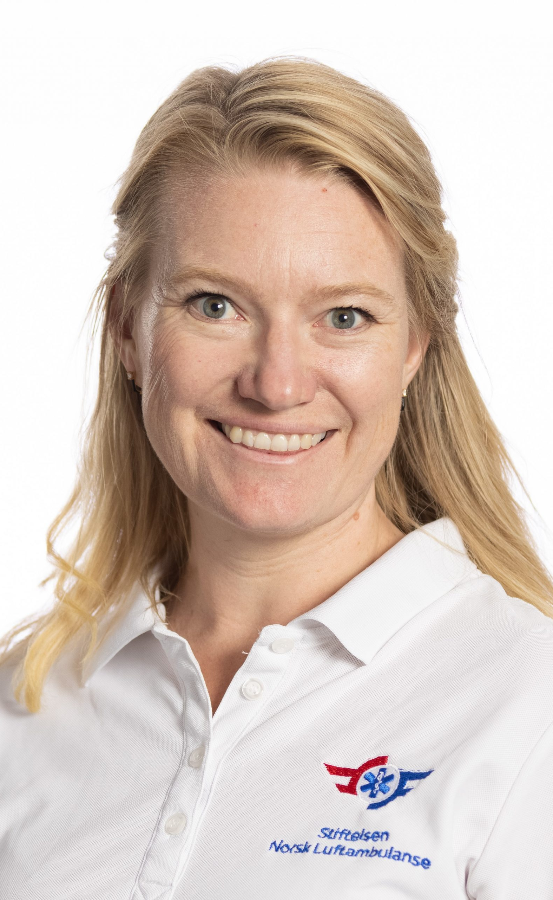
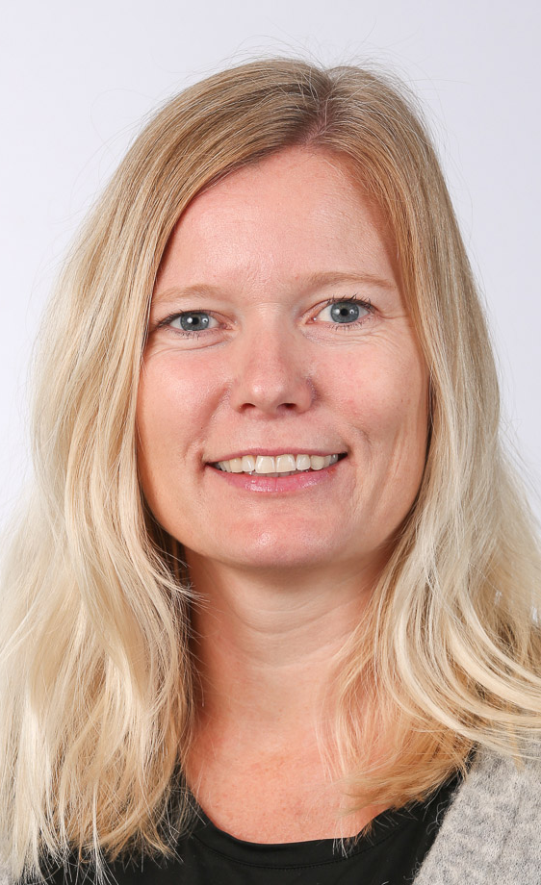
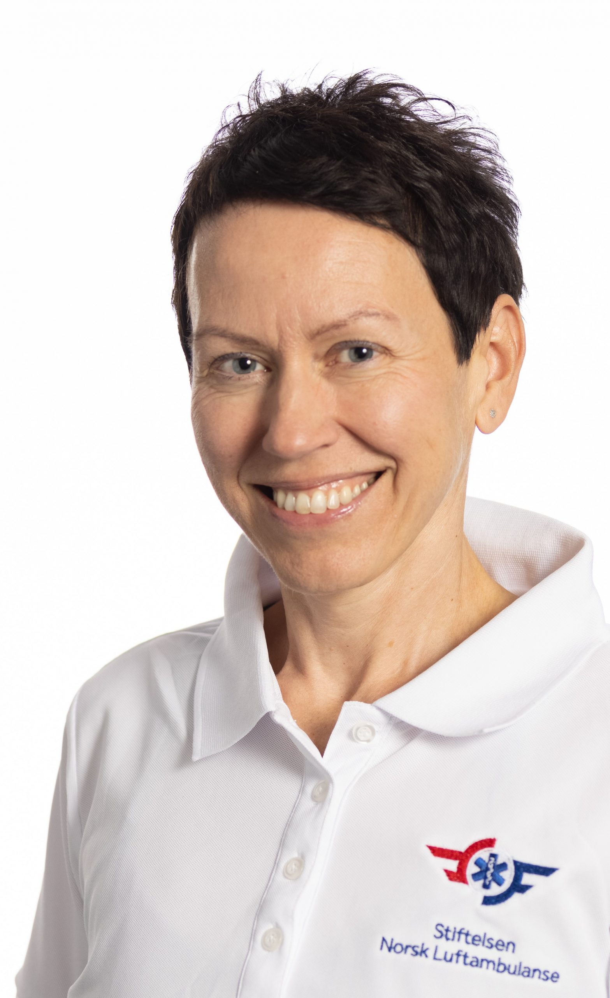
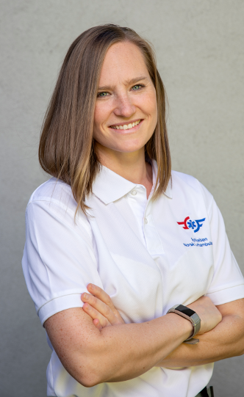
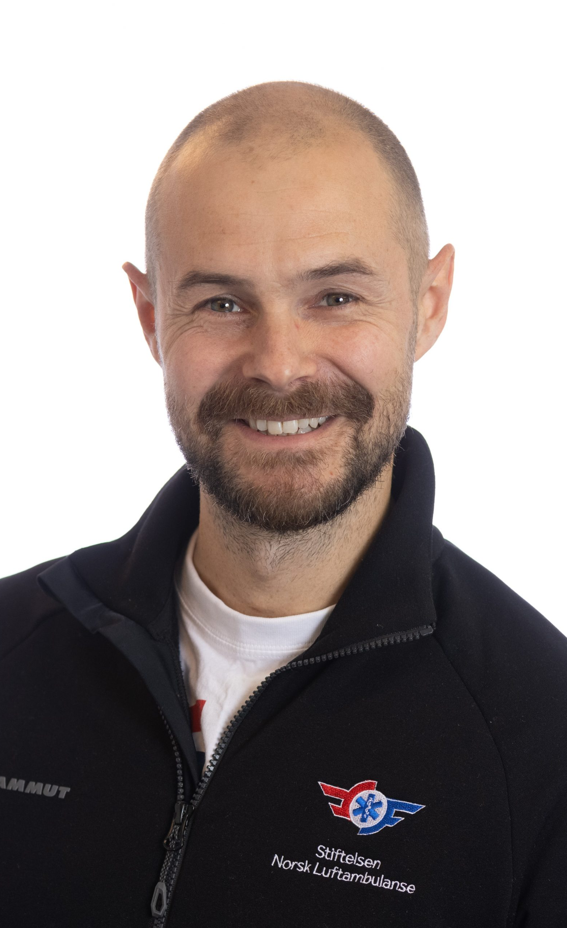
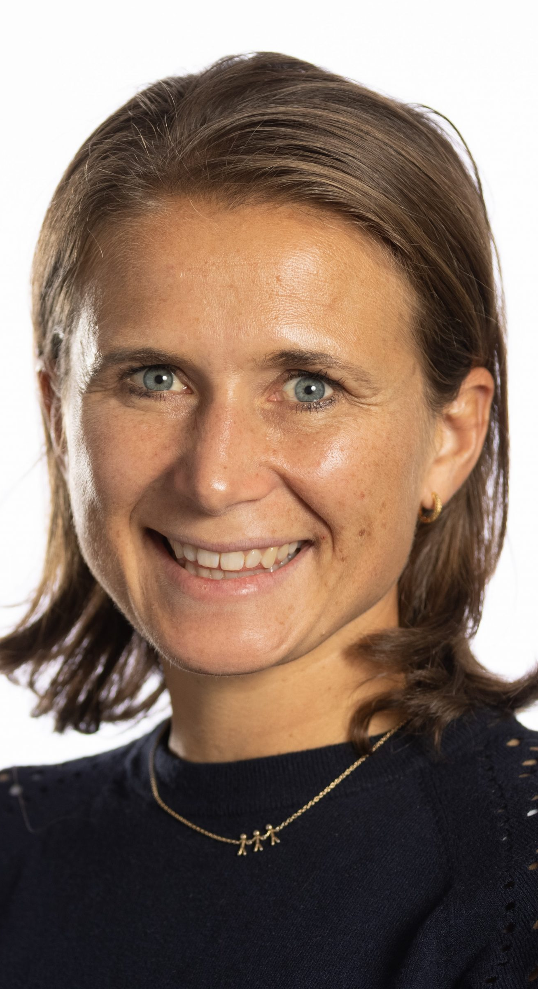



Else Charlotte Sandset MD PhD
Karianne Larsen MD PhD
Mona Guterud MSc PhD-cand.
Henriette Jæger MSc PhD-cand.
Helge F. Bugge MD PhD-cand.
Ingrid Hustad MD PhD-cand.
Maren Ranhoff Hov MD PhD

