Slide 1
Bringing closure
Jarle Ebeling
ICAME 38 – Prague
24. – 28.5.2017

Slide 2
Aim
Explore V + (emotional) closure as an extended lexical unit and as a cultural fact
Overview of talk
Examples of kinds of closure in the BNC
"Emotional" closure
Frequency of use in COCA 1990-2015
Verbs that collocate with (emotional) closure
V[DESIRE/WANT] closure

Slide 3
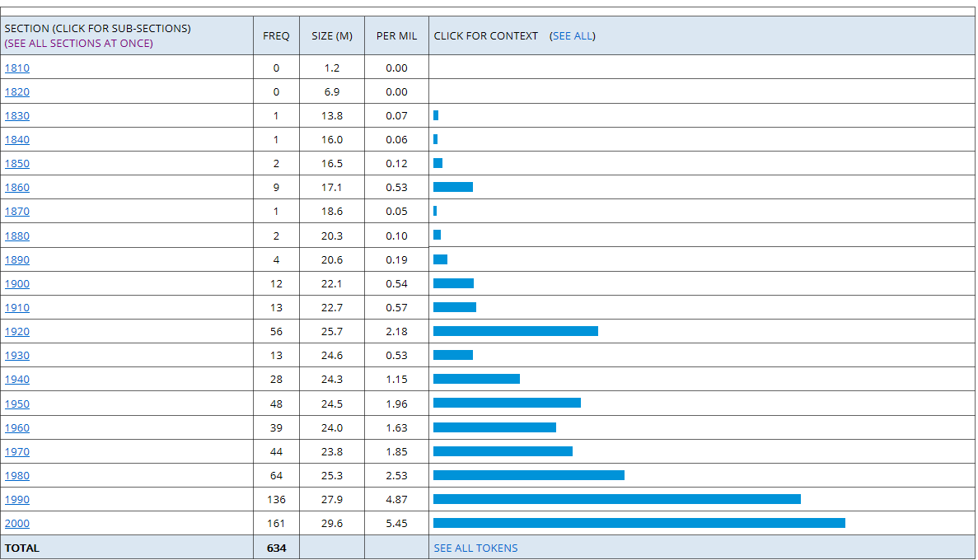
Piqued my interest
..., but Daniel still needed to put his own mind at rest. Achieve closure, as Miranda liked to say. [MarEdw1.s913]
"Sad. At least they 'll get closure now. The families I mean." [LucVes1.s4306]
Figure 1. closure in COHA

Slide 4
Kinds of closure in the BNC
(1,922 matches in 633 texts [BNCweb, CQP edition])
Concrete, observable, mostly (regarded/pitched as) undesirable [Ex. reactor]
factory/hospital/office/pit/plant/school/road closure
the (planned/possible/premature/recent) closure of the factory etc.
plant etc. faces/is earmarked/heading for closure
Concrete, observable, desirable/neutral
wound closure / colostomy closure
velar/alveolar closure
Abstract (metaphorical?)
narrative closure (neutral)
social closure (undesirable, e.g. access to private schools)
"emotional" closure (desirable)
(How many of this type in the BNC do you think?)

Slide 5
Only two clear instances
Sydney Schanberg put [sic] it as follows, "You do n't, as the psychiatrists say, "get closure" ." [G2E.s1951]
Part of Schanberg 's problem in achieving "closure" has undoubtedly been the degree of exposure that The Killing Fields has brought him. [G2E.s1987]
Source info: Harpers & Queen (Harper's Bazaar) [Written, W:pop_lore, Adult, Informative: Leisure, Perceived level of difficulty: Low, Medium of Text: Periodical, Target audience sex: Female])

Slide 6
Method
Extract 500 instances for each five year period from COCA between 1990 and 2015 (= 5 5-year periods/quinquennials)
2. Classify instances of the type "emotional" closure according to
the verb it collocates with
type of pre-modification of closure
genre (COCA)
note down if the use is highlighted/commented on (cf. the two instances from the BNC)

Slide 7
Table 1. Total no. of closure in each 5-year period
Quinquennial | Freq | Size (M) | Per mill.
1990-1994 | 792 | 104.0 | 7.62
1995-1999 | 962 | 103.4 | 9.30
2000-2004 | 824 | 102.9 | 8.00
2005-2009 | 789 | 102.0 | 7.73
2010-2015 | 957 | 121.6 | 7.87
Table 1a. No. of "emotional" closure in each 5-year period based on 500 instances
Quinquennial | 90-94 | 95-99 | 00-04 | 05-09 | 10-15
No. of occ. | 7 | 107 | 141 | 124 | 146
Percentages | 1.4 | 21.4 | 28.2 | 24.8 | 29.2

Slide 8
Table 2. No. of occurrence by COCA genre
Quinquennial | 90-94 | 95-99 | 00-04 | 05-09 | 10-15
ACAD | 1 | 5 | 12 | 12 | 18
FIC | 0 | 9 | 18 | 21 | 24
MAG | 2 | 13 | 19 | 16 | 22
NEWS | 2 | 18 | 28 | 22 | 30
SPOK | 2 | 62 | 64 | 53 | 52
Total | 7 | 107 | 141 | 124 | 146

Slide 9
Figure 2. Instances of V + (emotional) closure in COCA by genre

Slide 10
Table 3. Verbs occurring at least 5 times in one quinquennial
Quinquennial | 90-94 | 95-99 | 00-04 | 05-09 | 10-15
achieve | 1 | 2 | 5 | 1 | 3
be | 1 | 20 | 32 | 21 | 14
bring | 2 | 14 | 20 | 16 | 16
find | 0 | 6 | 10 | 4 | 8
get | 0 | 4 | 11 | 11 | 9
give | 1 | 2 | 3 | 8 | 6
have | 0 | 11 | 7 | 10 | 8
look for | 0 | 0 | 2 | 3 | 6
need | 0 | 3 | 1 | 9 | 6
no verb | 0 | 15 | 15 | 6 | 19
provide | 0 | 2 | 6 | 4 | 10
seek | 0 | 3 | 0 | 1 | 6
want | 0 | 5 | 5 | 8 | 7
Total | 5 | 87 | 117 | 102 | 118
Instances with these "verbs" account for approx. 80% of all occurrences.

Slide 11
Modification of closure
Approx. 42% of the instances have some kind of pre-modification or a determiner in front of closure
some: 42
a/some sense of: 24
no: 11
some kind of: 10
-- have had some horrible things happen in their life. They want some closure to this, and so they're hoping that ...
..., a good therapist gently helps you end the therapy and achieve a sense of closure.

Slide 12
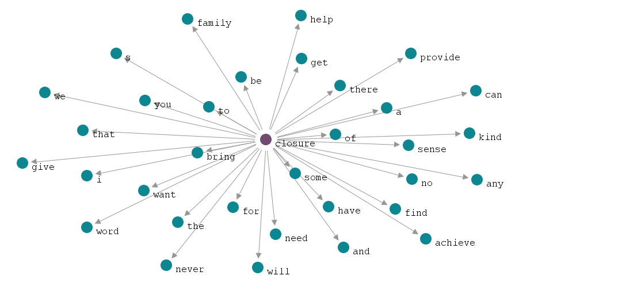

Slide 13
Different (verb) patterns
1. something brings/provides closure
But Steve Fritsch says the return of his brother's remains brings final closure.
2. someone achieves/finds/gets/has closure
You will never get this cancer off your marriage until you achieve emotional closure.
3. someone looks for/needs/seeks/wants closure
I'm not looking so much for justice for Toni, but for closure for the girls, ...
4. there BE closure
Well, today is sentencing. Hopefully, there will be closure for you and the rest of the victims.
5. No verb (use of closure highlighted/commented upon)
What's the most bullshit word in the English language. "Closure."

Slide 14
Levels of analysis
Concordance/ Collocation |  | ..., dead of a massive heart attack. There was a strangely satisfying kind of closure in this, Jane told Doug when she phoned him in Florida.
Colligation / Syntax | V + (pre-modification +) closure
Semantic preference/ Meaning | desire/want ending of bad experience | How long ago was 16 years? [...] I mean, some things we - I've had to learn to live with. [...] Don't heal, they don't, they don't, and this - and they don't close. There's no closure. There's no healing, there's no closure.
Semantic prosody / Communicative purpose | come to terms with / "carry on" / healing

Slide 15
V[DESIRE/WANT] closure
Types of social facts (cf. Stubbs 2014: 50, Table 1)
Institutional facts are ontologically subjective but epistemically objective (marriage, money, professorship)
What about:?
pleasure, fear, excitement, desire: ontologically and epistemically subjective
Depends on personal experience/judgement (epistemically subjective), yet meaning and use shared and understood by a (speech) community (ontologically subjective)
Do we need a new/different term for these?
Culturally entrenched speech acts?
Cultural (f)acts?

Slide 16
Avenues of further research
Syntactic flexibility/versatility (Cp. e.g. the fixedness of come to terms with with the several different (types of) verbs closure collocate with)
Diachronic development (Why/When did it become a household expression? Is it a new concept? Or new "name" for an hitherto, non-articulated concept/feeling?)
Genre spread (Has it spread to all genres/text types? All variants of English?)
Cultural dispersion (Has it "travelled" as a new concept? (How) Is it articulated in other languages?)

Slide 17
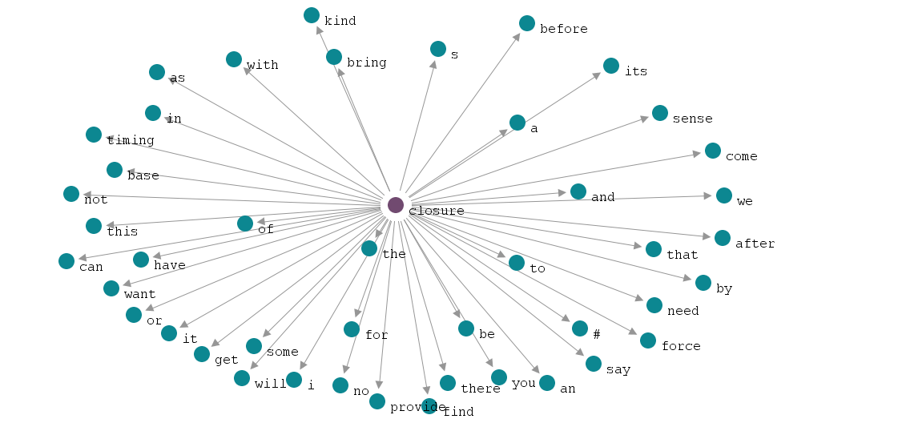
Notes:
Using LancsBox to get a first overview of words collocating with closure (all 2,500 instances lemmatised). Focus on verbs with a strong collocational strength
LancsBox: T-score, Span 5<>0, Statistic value: 5, Collocation frequency: 5
Corpus: Corpus 1| Search Term: closure| Statistic: 10 - T| Span: 5-0| Collocation freq. threshold: 5.0| Statistic value threshold: 5.0| CPN: 10 - T/ L5-R0/ C: 5.0-NC: 5.0|

Slide 18
Different (verb) patterns
1. something brings/provides closure
But Steve Fritsch says the return of his brother's remains brings final closure.
First, it provided closure and shared knowledge with a wider audience.
2. someone achieves/finds/gets/has closure
You will never get this cancer off your marriage until you achieve emotional closure.
It's really about helping people find closure and ...
I think they need to get some closure.
3. someone looks for/needs/seeks/wants closure
I'm not looking so much for justice for Toni, but for closure for the girls, ...
Anyway, she says, if a person wants closure, they got ta deal with their problems head on.
4. there BE closure

