Slide 1
IT-konferansen 2019
Using AI to generate alternative text for images
Monica Stamnes (slides by Tomm Eriksen)
USIT
Notes:
Monica Stamnes, gruppe for publiseringsløsninger. Jeg skal snakke om hvordan vi har brukt AI til å generere alt-tekster for åpne bilder i Vortex.

Slide 2
What is universal design or accessibility?

Slide 3
What is universal design or accessibility?
https://www.youtube.com/watch?v=_IShnvESLdI
Notes:
En kort presentasjon fra Difi om hva universell utforming er.
DIFI: Direktoratet for forvaltning og IKT

Slide 4
What is universal design or accessibility?
Notes:
WCAG: EUs webdirektiv om universell utforming av offentlige nettsteder og mobilapplikasjoner (WAD).
Retningslinjer for tilgjengelig webinnhold; kort oppsummert gjøre det mer tilgjengelig for alle. (Lesbarhet; kontraster, tekstavstand, labels, fargekontraster osv.)
https://www.w3.org/Translations/WCAG20-no/

Slide 5
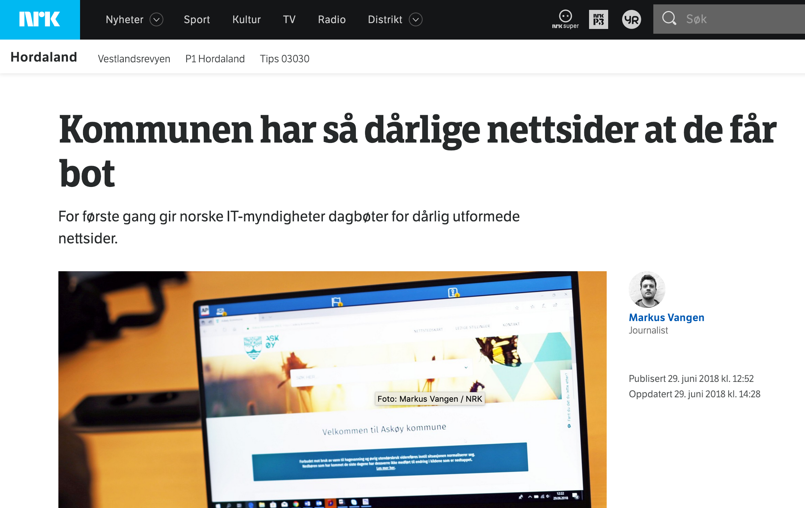
Motivation
Universal Design Laws in digital products now applies to all Norwegian universities including teaching material
Businesses have begun to get large fines from DIFI for breaking the law
DIFI will look very closely at Universities and accessibility in 2019
UiO webpages ranked as best university in Norway in 2018 regarding UD, but we are not satisfied (with 93. Place of 278 businesses)
Many UD-errors are due to "errors" made by publishers
Notes:
* UU-kravene gjelder også UH-sektoren, inkludert læringsmateriale, f.eks. Canvas...
* DIFI: Direktoratet for forvaltning og IKT
* Askøy kommune: Blant annet er sidene svært dårlig tilpasset for blinde og svaksynte. 10k dagen.
* SAS: Billettbestilling. Ikke sikret at de er mulige å bruke for alle.
* Gjør publiseringsløsningen vår nok for å hjelpe de som publiserer med å lage innhold som er tilgjengelig for alle? Nei...

Slide 6
Analysis and concept
The most common accessibility issue on our website is missing alternative text on images
We have done a thorough analysis of our 250.000 published photos, and approx. 60% of photos on UiO are missing or have a low quality alternative text
At the same time, UiO has signed an agreement with Google to use Google Cloud services
By combining two Google APIs (Vision and Translate), we can autogenerate all-text on images
Notes:
Vet alle hva alternativ tekst er? En alternativ bildetekst, eller alt-tekst, er en beskrivelse av hva bilder på nett inneholder og eventuelt hva bildet lenker til.
Gå til https://cloud.google.com/vision/ og hent frontebildet fra forsiden til Molde

Slide 7
hiof.no
himolde.no
uio.no
User
uploads
image
Keyword1,
Keyword2,
Keyword3,
osv…
Keyword1,
Keyword2,
Keyword3,
osv…
Emneord1,
Emneord2,
Emneord3,
osv…

Slide 8
Analysis and concept cont.
Using these services from Google will cost us a few thousand NKR a year Facebook has been doing this for quite a while already Assessed as a valuable measure by both internal and external UU expert

Slide 9
DEMO

Slide 10
Technical: How does it work
Analyze
Vortex Cache
Hash of raw image data
have identical image been
analyzed before?
G. Vision
Use a library to send entire image.
(no need to reveal name and location)
fetch keywords
(top «n» best at «y» quality)
G. Translate
Simple HTTP POST
(query contains very little data)
translate to norwegian

Slide 11
Status and further work
Started development in mid-January ROS Analysis
Restricted to open images Data Processing Agreements with customers must be updated First version is implemented and in production
Gradual rollout to a select set of users (~30 people) in early March through feature toggling in the CMS
Collect feedback, evaluate and improve before full rollout
In production now for all open images at UiO

