Slide 1
Autotekst: Making the best AI-models for transcription available to end users in education in Norway AI4LAM June 2024 Oddmund Møgedal, University of Oslo
With customized models from the National Library, Autotekst provides even better transcription of Norwegian (including dialects) and better support for both Norwegian written forms
Available in autotekst.uio.no and for Panopto since April 2024

Slide 2
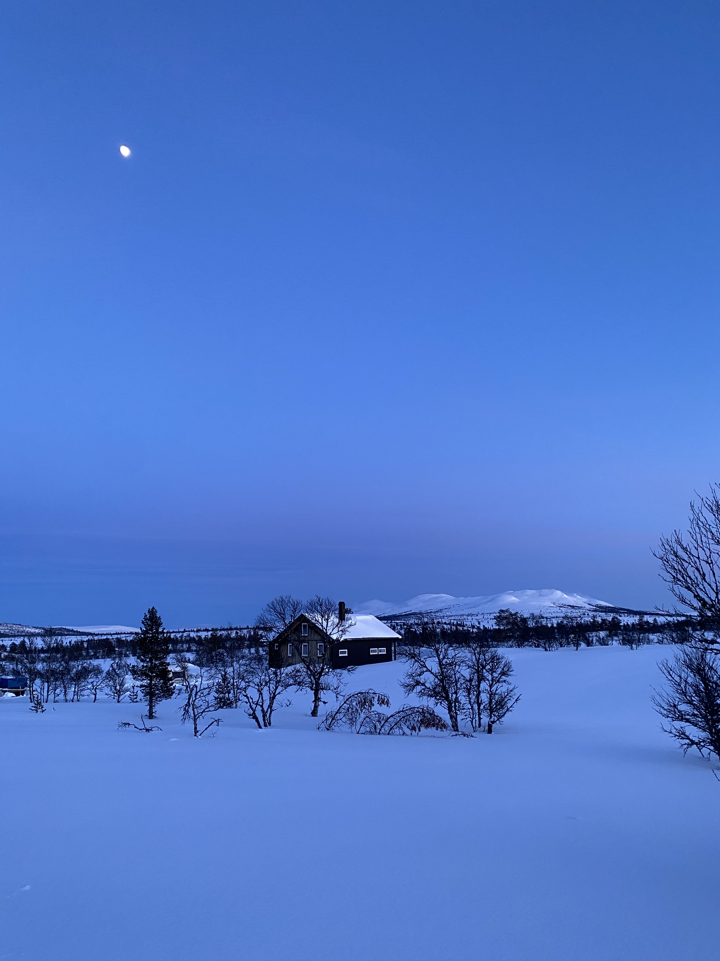
I am in a remote location today, so there may be a few seconds delay while my Starlink dish finds a new satellite
Now
Winter

Slide 3
Autotekst?
In many cases the best solution for Norwegian speech-to-text
Based on Whisper from OpenAI, and customized models from the National Library of Norway
Available through
autotekst.uio.no
Web application where users can upload their media files to have them transcribed
Available to all employees and students at customer institutions
AutotekstVMS for Panopto
Transcription service for Panopto (Video Management System) to automate transcription as much as possible
Nettskjema med Nettskjema-diktafon
Large scale web-based survey tool with apps for recording media and automatic transcription

Slide 4
Autotekst availability and usage
Available since early 2023, new models since April 2024
For the higher education sector in Norway
About 30 customer institutions for autotekst.uio.no about half as many for AutotekstVMS for Panopto
autotekst.uio.no: 50165 files transcribed, 28726 hours
AutotekstVMS: 4567 files transcribed, 4456 hours (since late 2023)
Nettskjema med Nettskjema-diktafon, about 18000 hours (mid 2023 to mid April)
Can be ordered by all non-commercial institutions in Norway
We are considering availability and demand in other Nordic countries

Slide 5
Characteristics
Goal: Making the best AI-models for transcription available to end users in education in Norway
Lecture capture is important, but many other types equally important
New models from the National Library really help
Better accuracy in general for Norwegian
Better support for Norwegian dialects
Better support for Nynorsk (one of the written forms)
Leverage our own research infrastructure
Security and GDPR/Personally Identifiable Information
SLURM for GPU job scheduling
We always run the largest models
Convenience is important, not only quality
Transcription should be as hassle-free as possible
Good user experience
Good performance for users
As invisible as possible (e.g. Panopto VMS integration)
Automatically insert disclaimer when transcription is used without QA

Slide 6
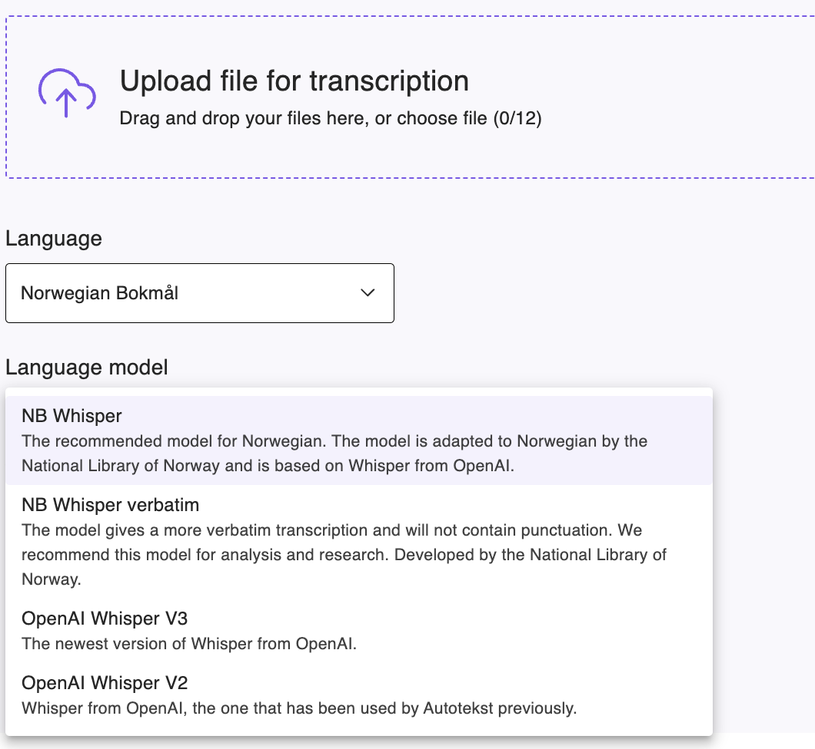
Multiple models: good defaults help, but sometimes users need to choose for themselves...

Slide 7
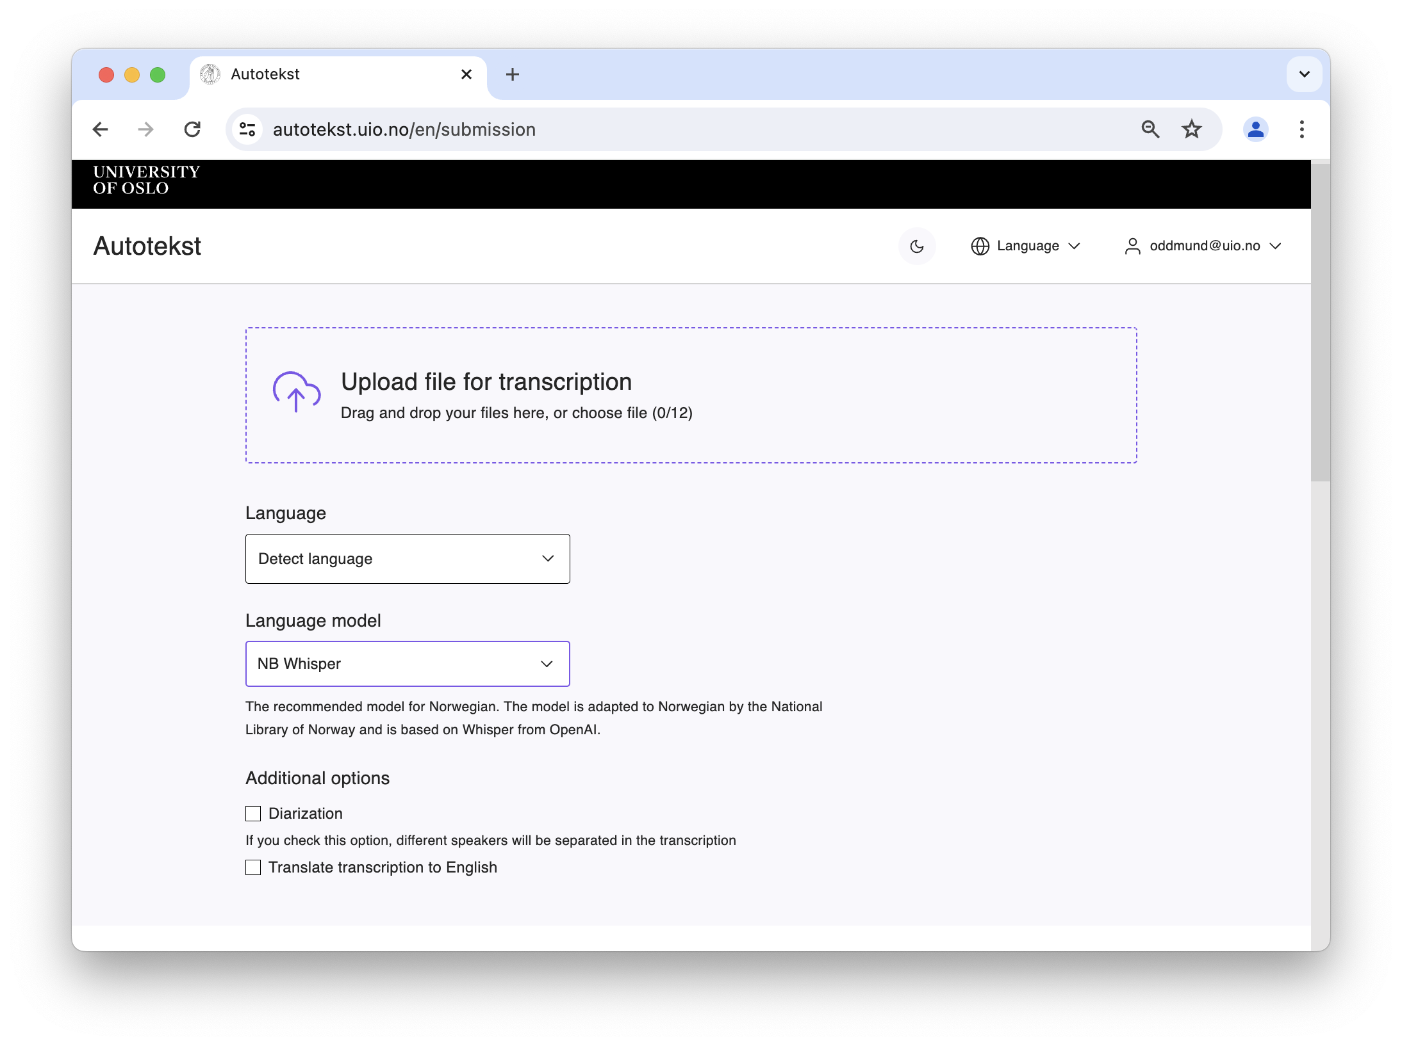
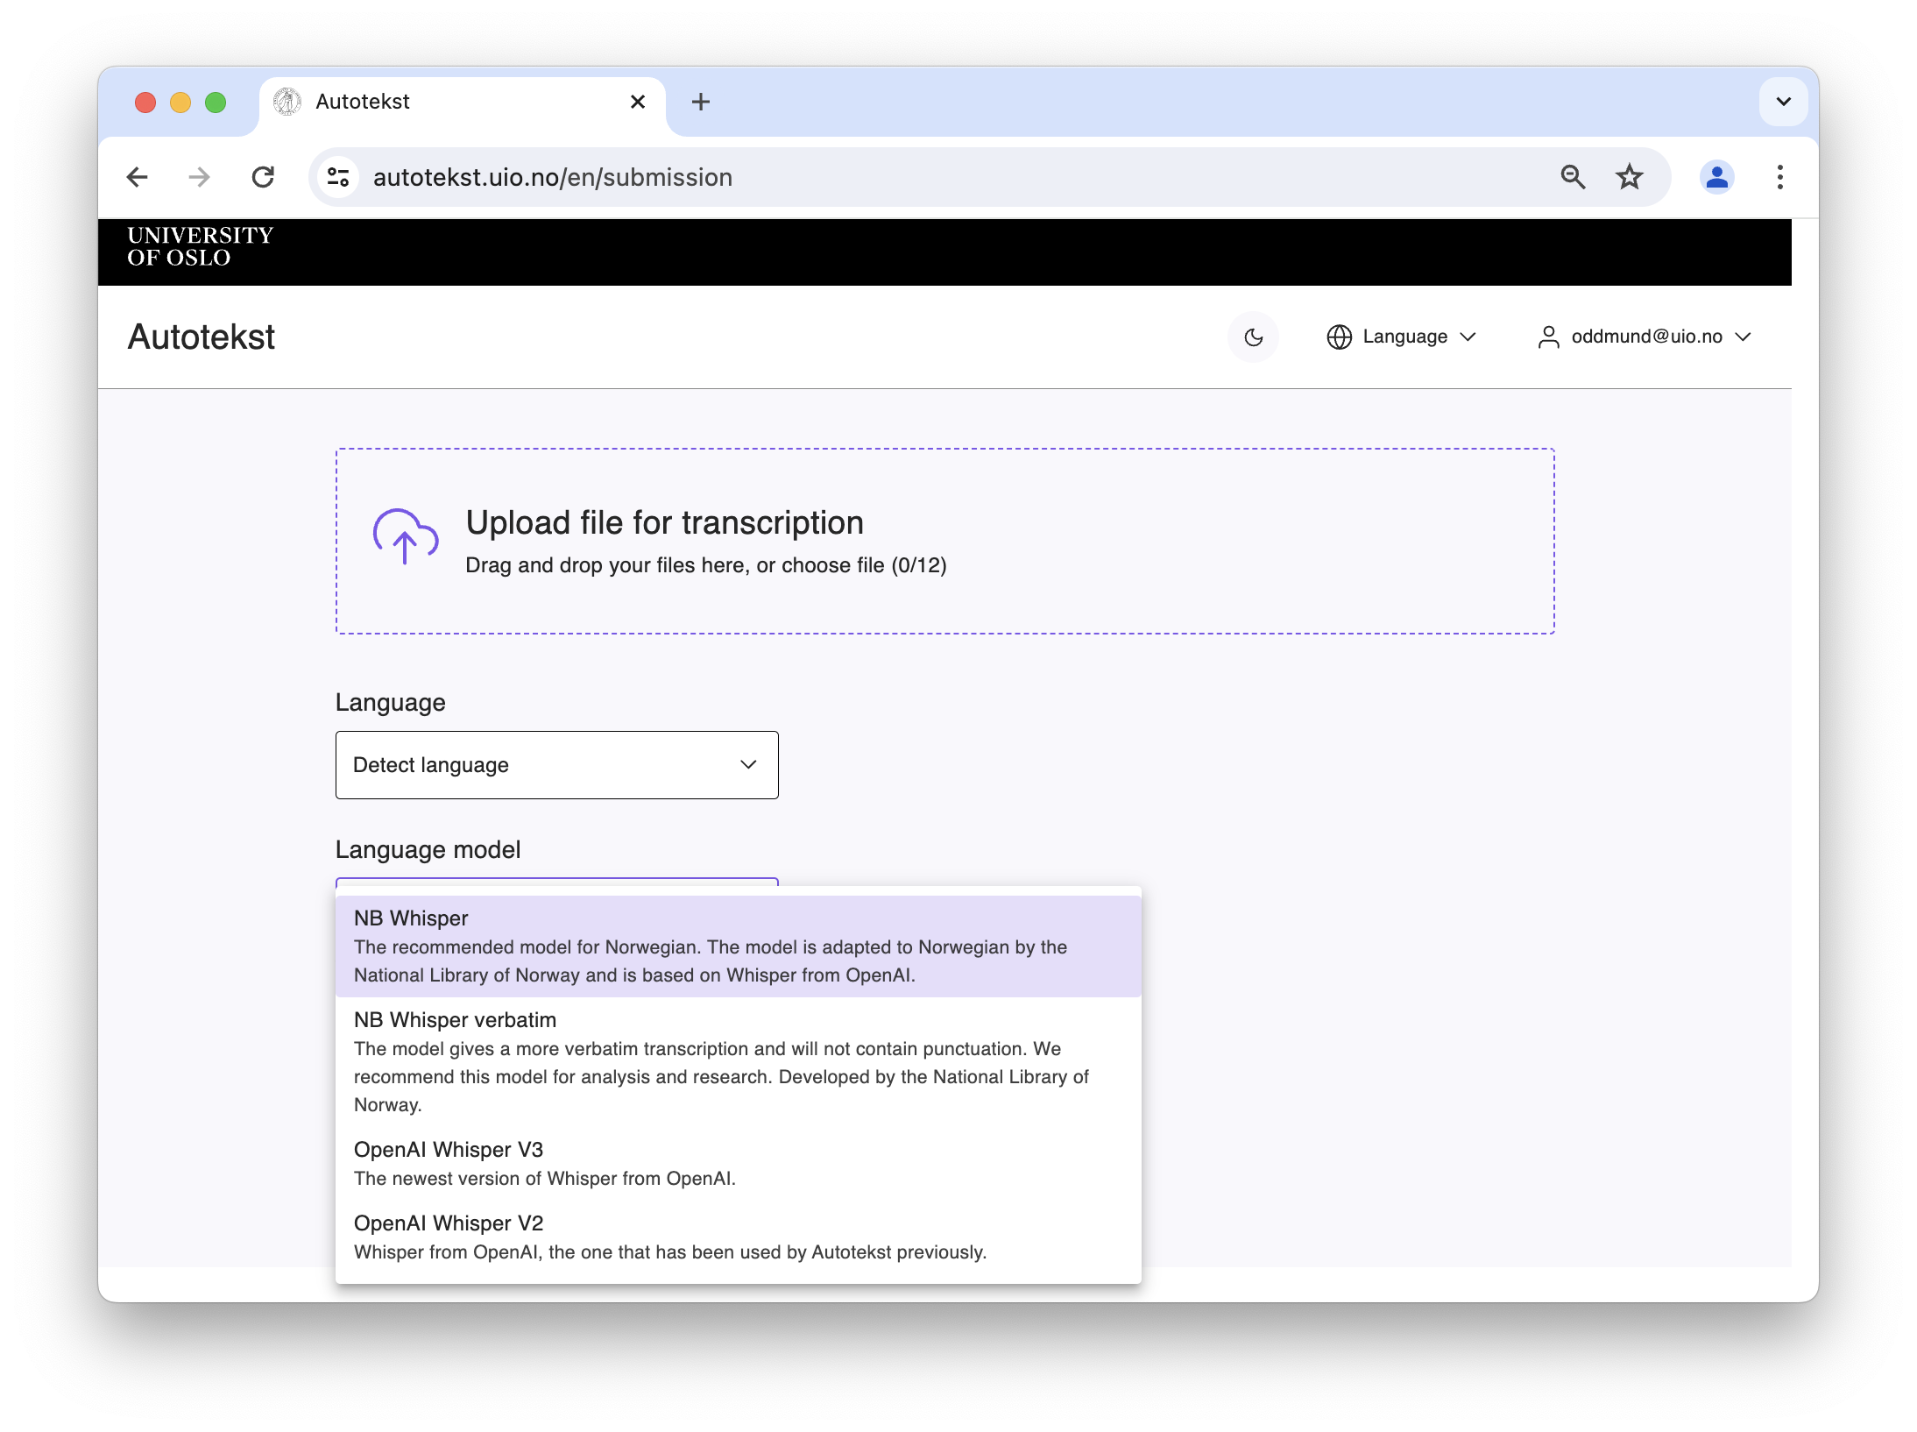
autotekst.uio.no: upload and model selection

Slide 8
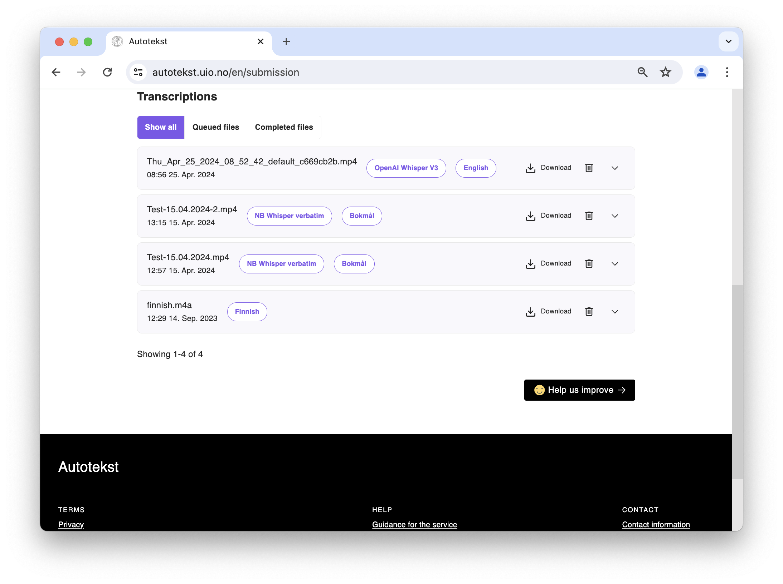
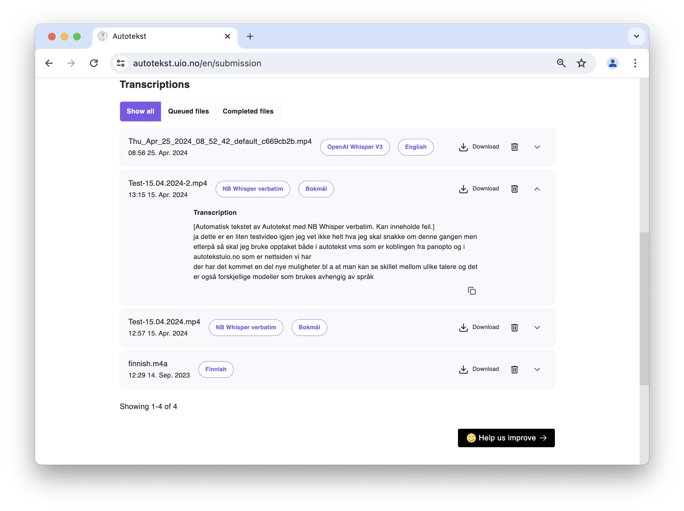
autotekst.uio.no: list and preview

Slide 9
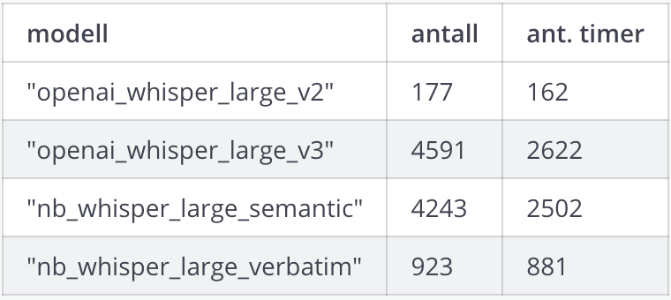
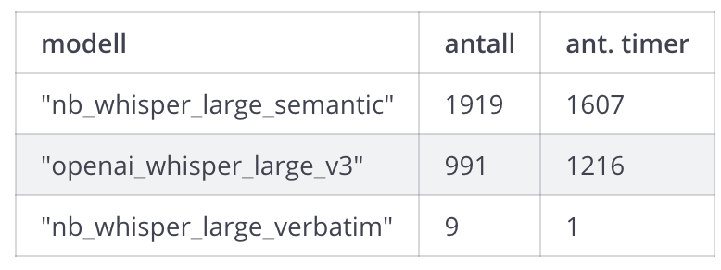
Model usage after April 6th
autotekst.uio.no
AutotekstVMS

Slide 10
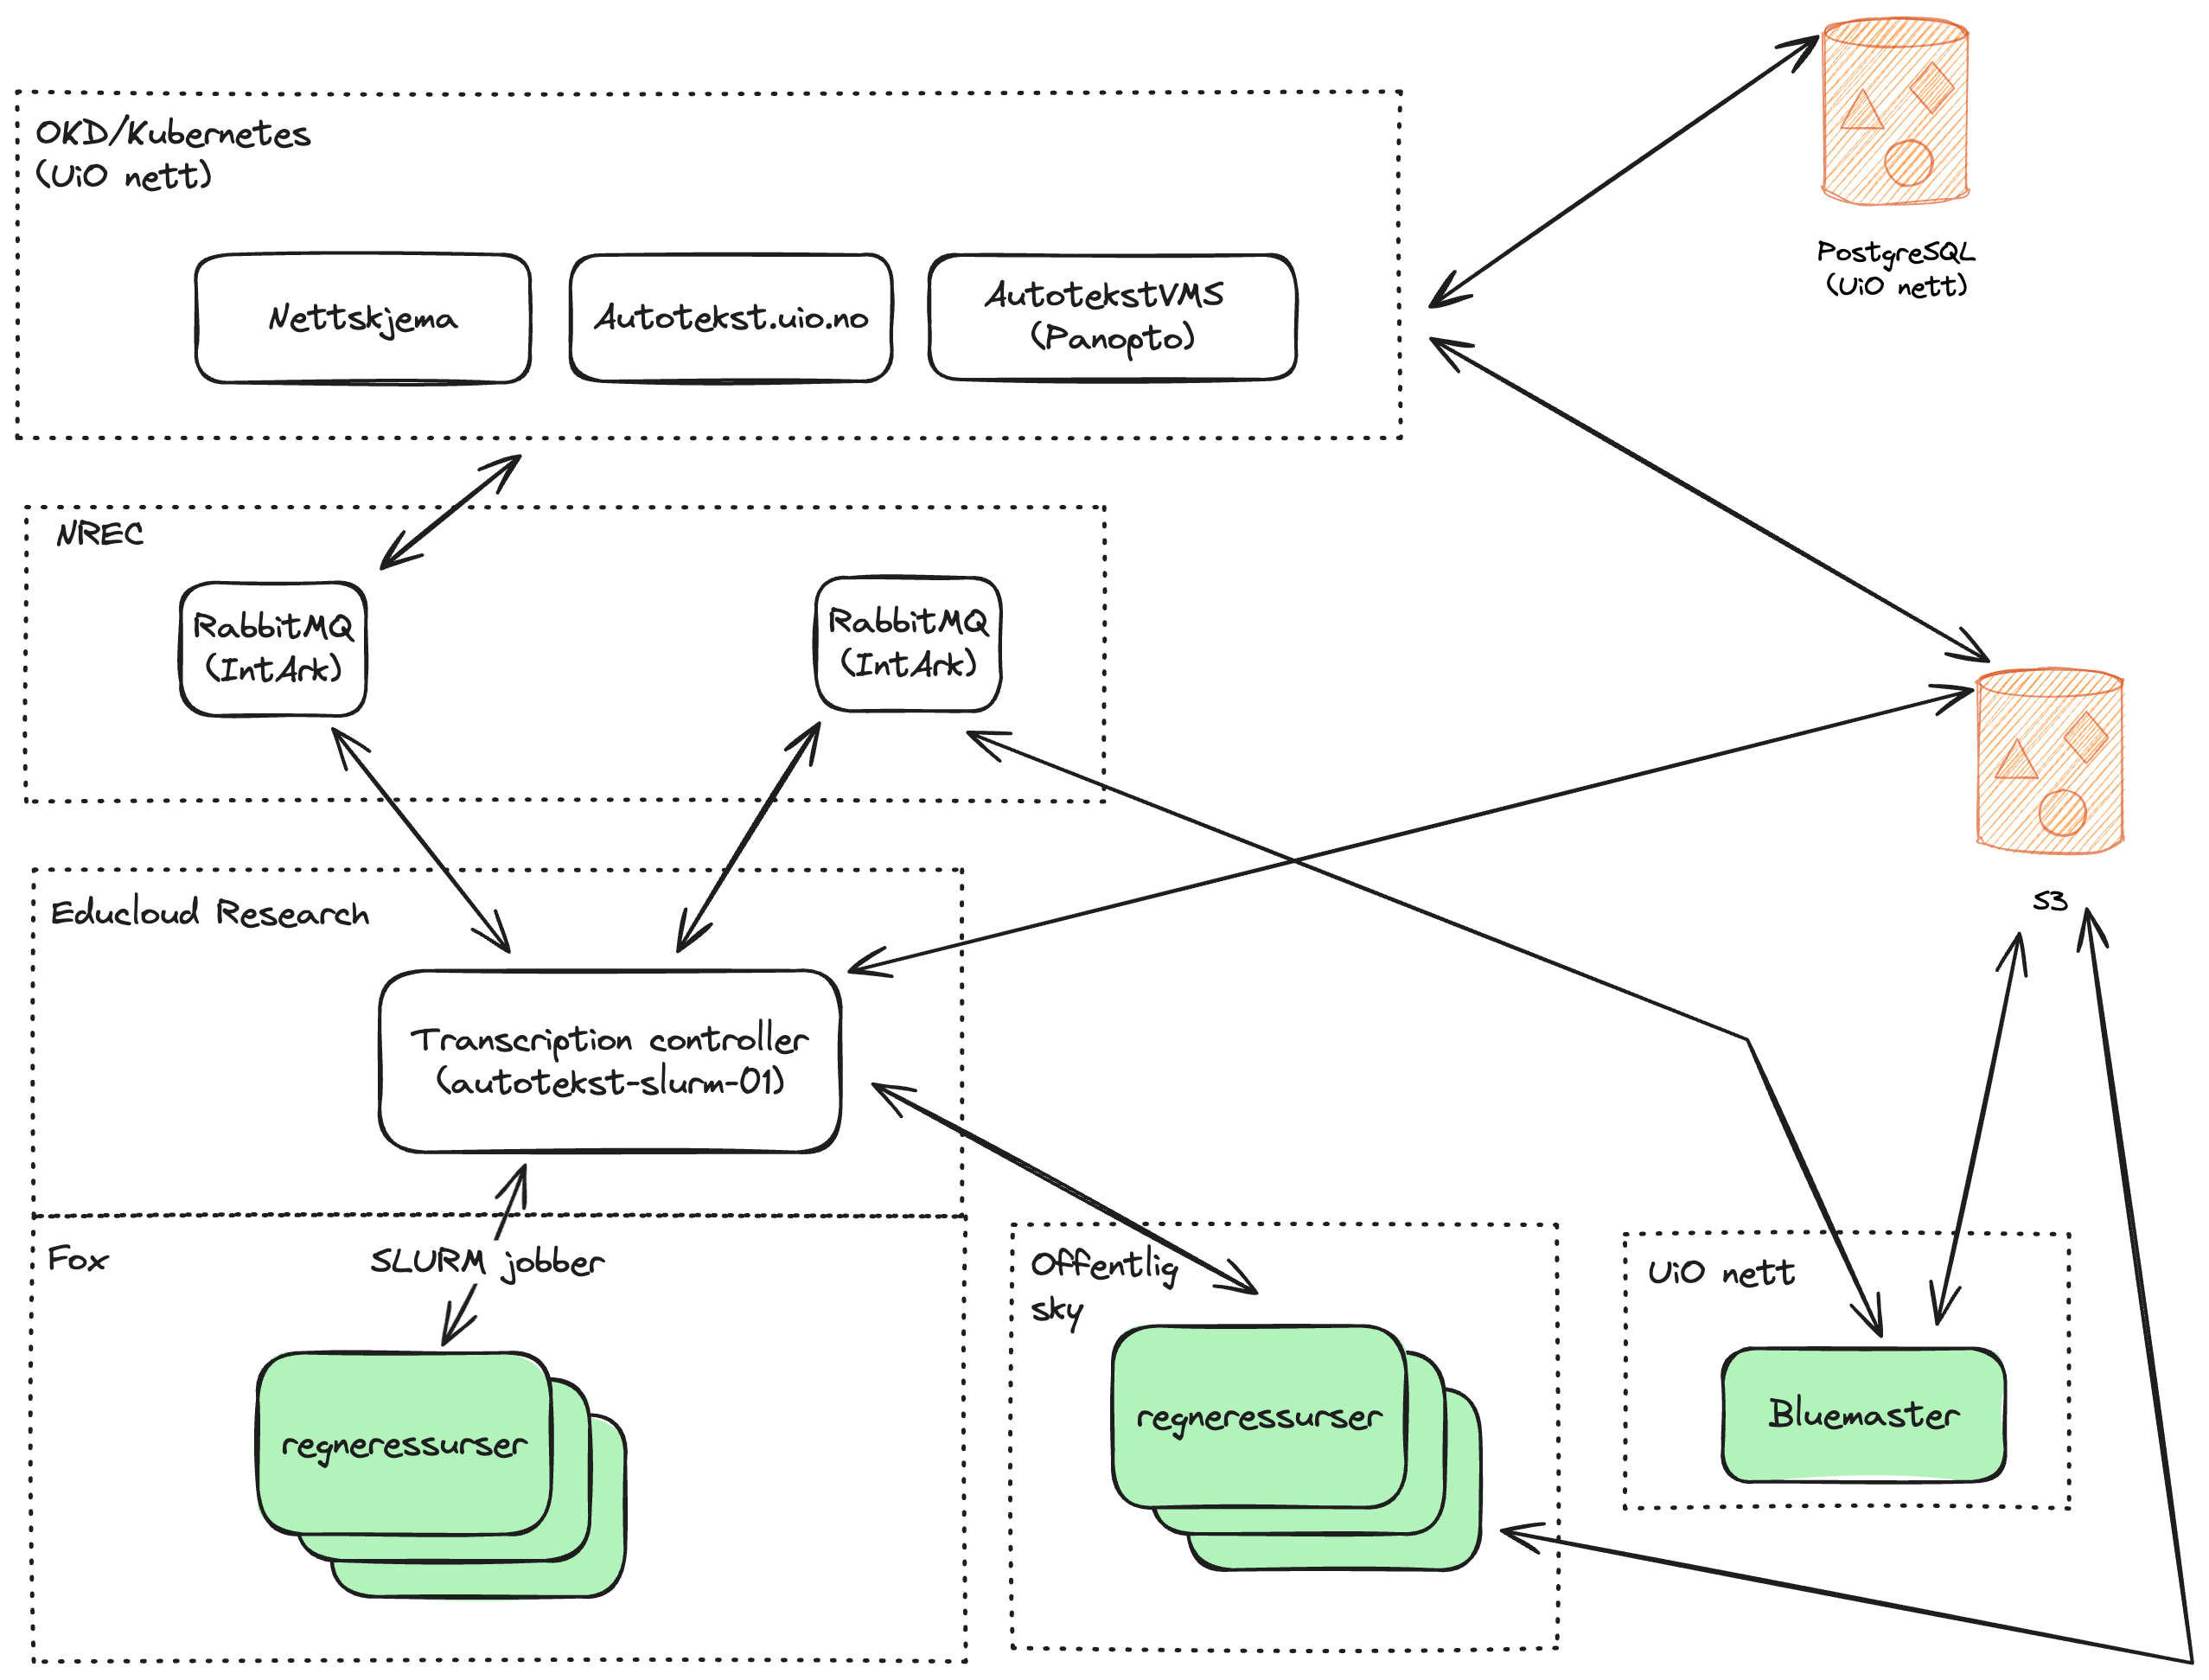
Current architecture with processing in Educloud Research (Please excuse some Norwegian labels)
Kanskje senere
Notes:
OpenShift Kubernetes

Slide 11
Current plans
Support automatic language detection before choice of model
More flexible handling of high loads (priorities etc.)
Better usage statistics across applications

Slide 12
End
Anyone have more information on improved Whisper models now or upcoming for the other Nordic languages?

