Slide 1
Early experience with Autotekst (Whisper) as a captioning service for Panopto
NCW23
Oddmund Møgedal

Slide 2
Some background

Slide 3
Timeline: UiO Autotekst beginnings
Attempt to “solve” speech-to-text for our university
Started in the autumn of 2020
Initially used Google speech-to-text
Launched Autotekst web app in 2021
Has been the main solution for speech-to-text at UiO since then
Initial Google speech-to-text solution: lots of work needed to correct transcriptions manually after processing

Slide 4
21. September 2022 New opportunities

Slide 5
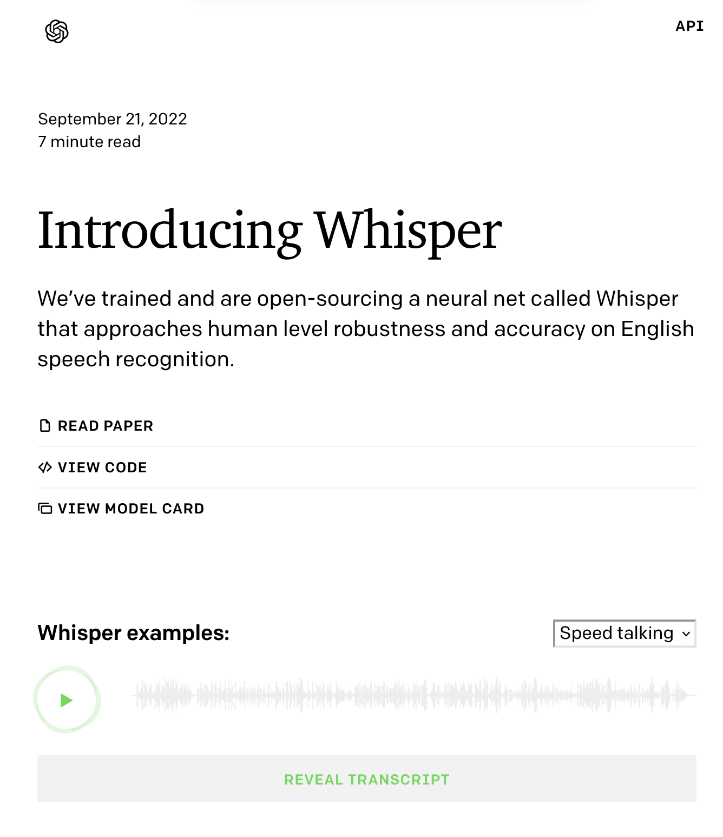
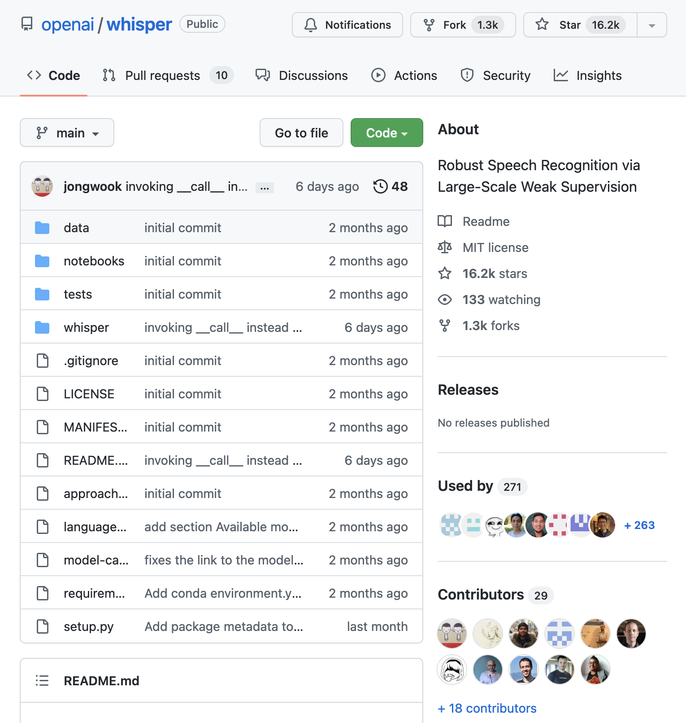
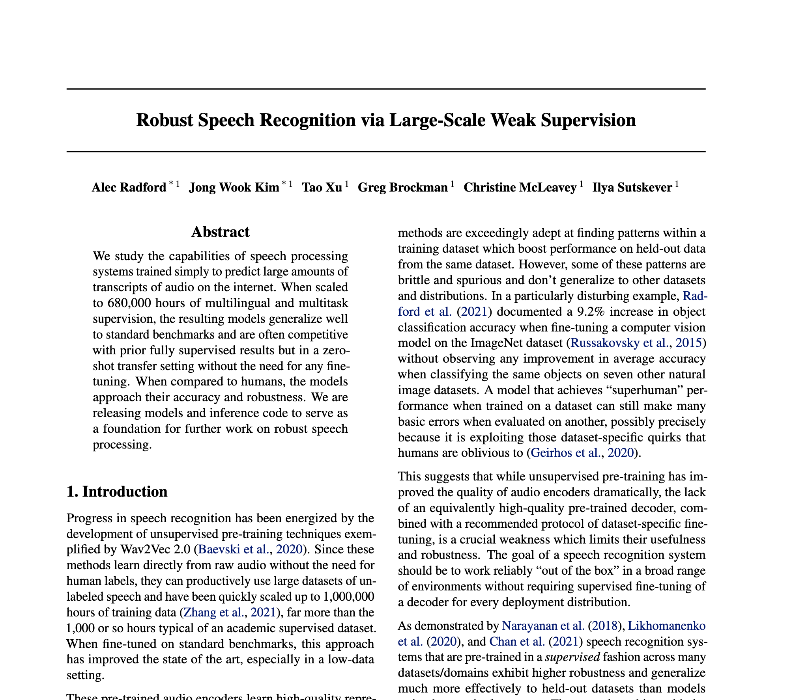
Lansering av Whisper

Slide 6
UiO Autotekst
Finally speech-to-text that works reasonably well in Norwegian

Slide 7
Hvordan fungerer Autotekst med Whisper?

Slide 8
Feedback so far on the Whisper version - a lot better than alternatives

Slide 9
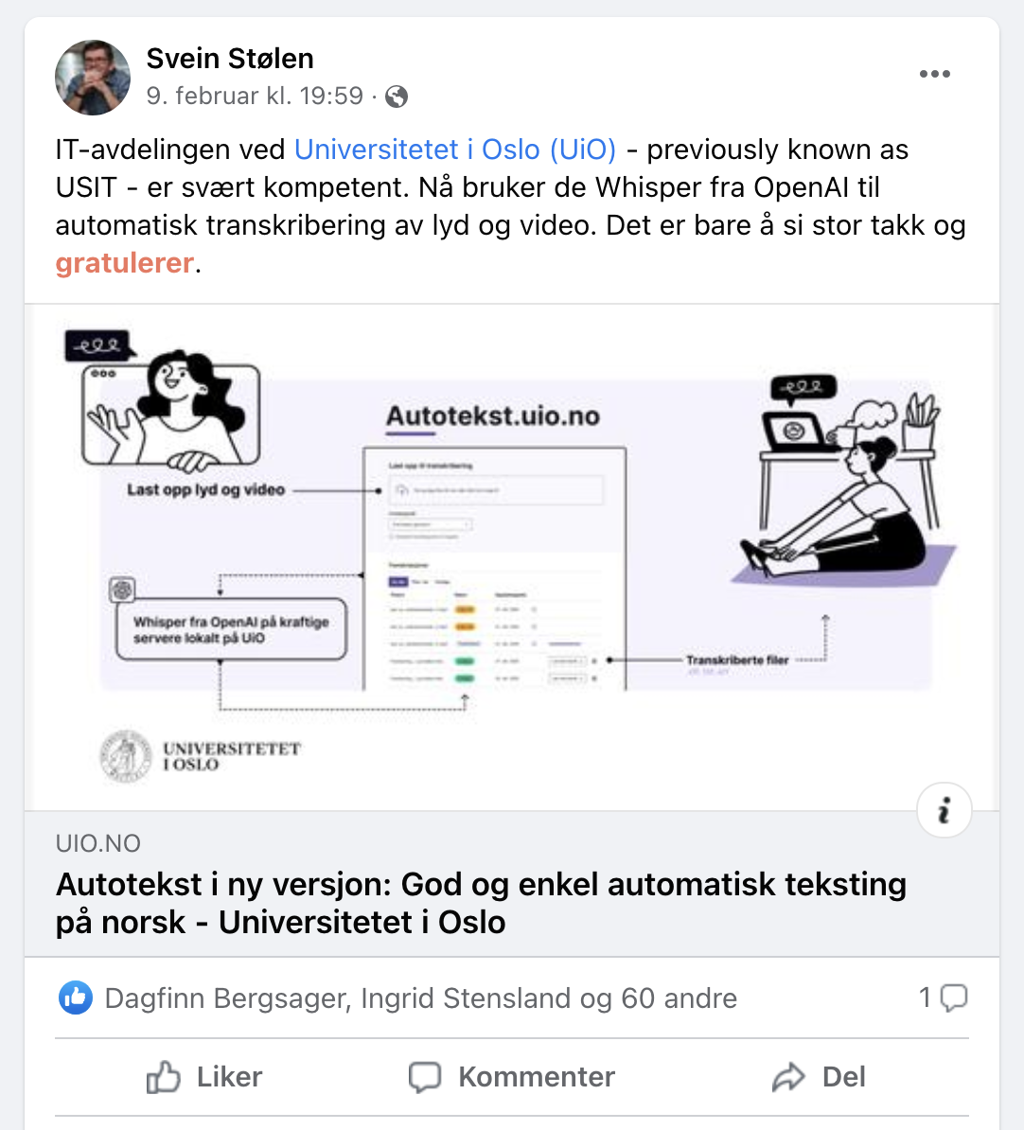
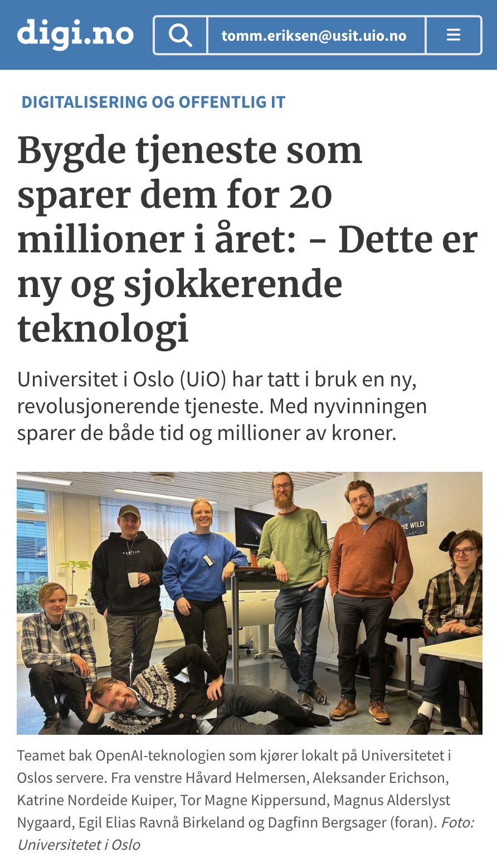
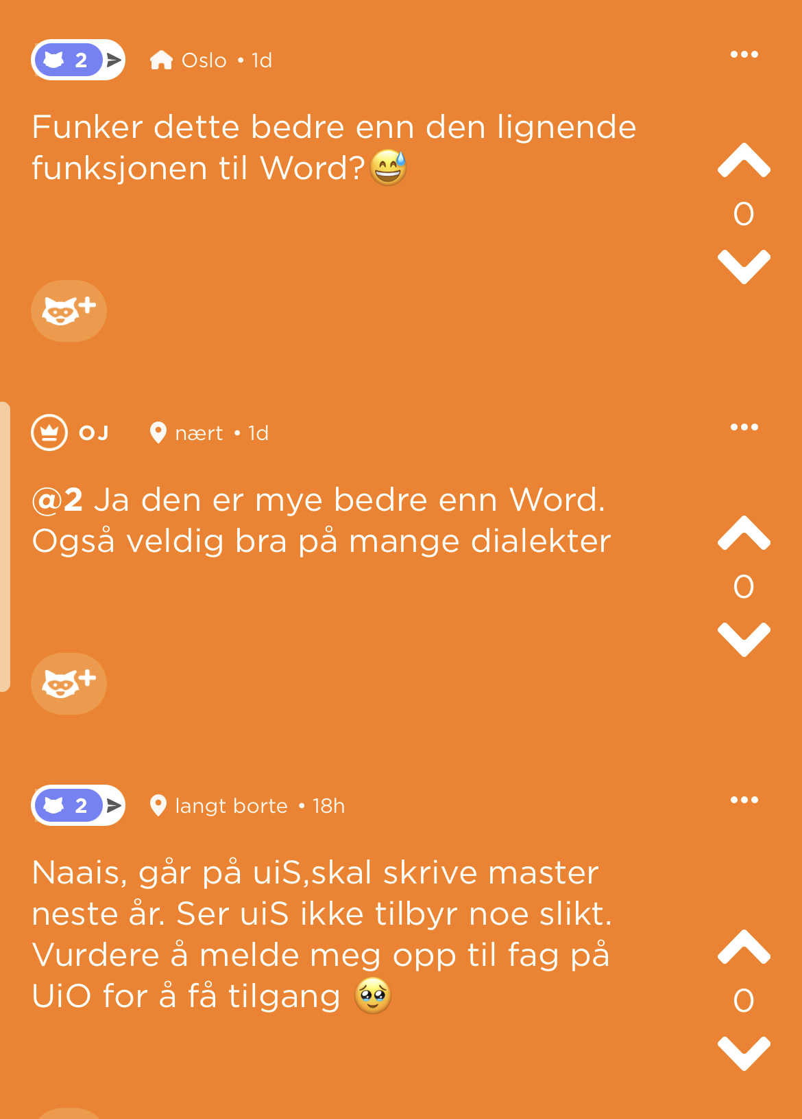
Reaksjoner de første ukene

Slide 10
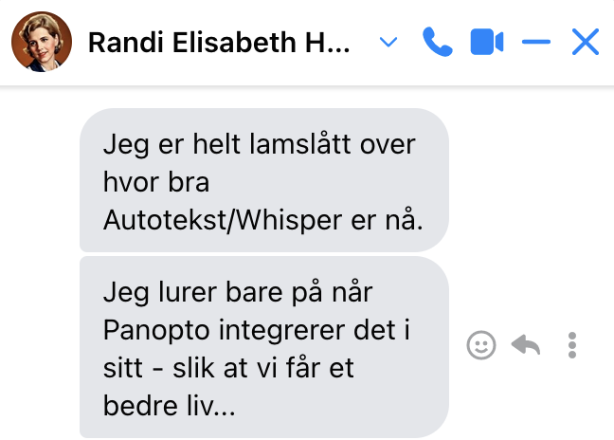
Må bare si at det strømmer inn gode ord om autoteksttjenesten etter oppgradering til whisper! Det er stor glede over hvor bra den har blitt, og så langt har jeg kun hørt om tekster som har vært så og si 100 % korrekt, så med andre ord svært lite etterarbeid. All kred til dere!!
– Marte Veierød, nettredaktør UiO
Det er virkelig helt fantastisk at dere har laget dette programmet, det letter en enorm byrde både i tid og penger fra mine og andre forskeres skuldre!
– Eva Stambøl Postdoc UiO
Nå har jeg allerede fått testet med en video som vi har her, med dårlig lyd og møredialekt. Dette er et kvantesprang
– Kjetil Knarlag, HK-dir

Slide 11
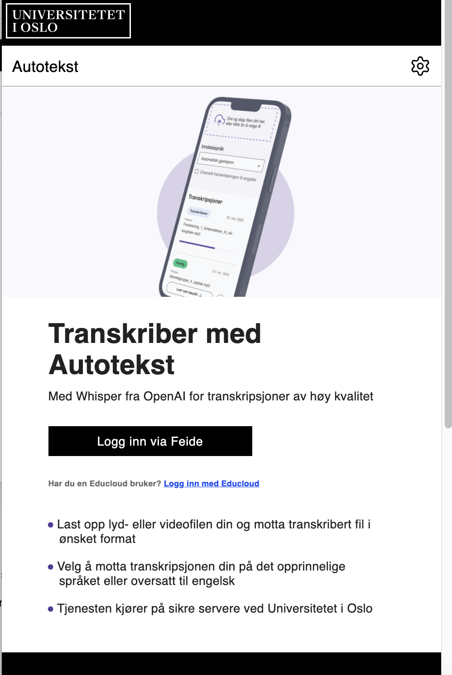
Experience with Autotekst Whisper version so far
Better than alternatives for Norwegian
Works well with many dialects
Cleans up false starts and incomplete sentences
Many errors are consistent, easier to clean up after
Quite good at guessing language if not specified
Works with audio and video files
Does not distinguish between multiple speakers
Sometimes bad results: if so, try again!

Slide 13
Whisper at UiO
TSD (sensitive data)
Autotekst
Nettskjema
Panopto coming
Additional local versions

Slide 14
Panopto integration as a captioning service

Slide 15
Why integration with Panopto?
Without integration it requires quite a lot of manual work to take video out of Panopto, upload to Autotekst and return the results to Panopto
Users have asked for integration, and other institutions in Norway have also shown strong interest

Slide 16
Timeline: Integration of Autotekst with Panopto captioning API
New Panopto captioning API became available this spring
Requires agreements with Panopto, which took some time to complete
Developed initial version in the last week of August 2023
Currently testing with Panopto test sites at UiO, NTNU and HVL in Norway
Expect pilot with production data at UiO starting this week
Expect production at UiO within a few weeks
Other places?
Will depend on demand, commercial agreements and need for scaling
We are not planning to make a lot of money, but need to cover costs
Could use outside Norway if there is interest in the Nordic region
Happy to test with other languages if desired, here or later

Slide 17
Demo

Slide 18
Experience with Panopto integration so far
Works the same as Autotekst with regard to quality (no surprise)
Takes a minimum of a few minutes in overhead on the Panopto side
If not used as default captioning provider, need a few manual steps in Panopto
Easier to use as default captioning provider, e.g. for a folder, but then it is hard to limit the volume of transcription requests
Possible to re-run transcription after occasional bad results

Slide 19
Technology for Whisper backend and API server
Backend
Backend server is a “left over” IBM Power server shared with Nettskjema/Autotekst etc.
8 V100 Tensor Core GPU cards running Whisper (currently 2 generations behind “the best”)
RabbitMQ job que
Private S3 storage
API server
HAProxy load balancer
Private OKD (Kubernetes OpenShift)
nginx
Node.js
PostgreSQL database

Slide 20
Opportunities for scaling

Slide 21
Panopto video is different from TSD/Nettskjema
TSD/Nettskjema is approved for special categories of personal information (research on health conditions etc.)
Need to do all processing in-house, and things need to be strictly locked down
UiO traditionally does scientific processing in house or in collaboration with other research institutions
Panopto video generally requires a lower level of protection
Still need to satisfy GDPR requirements
Could buy more hardware, and probably will to some extent
Could probably scale the Whisper process in the cloud as well
Less initial cost, but higher cost per hour
More flexible and suitable for temporary needs/high peaks of usage?

Slide 22
Questions?

