Slide 1
Drift med SCCM
Remote Manage App fra Cireson
Ernesto Gonzalez-Benitez
Gruppe for drift av Windowsklienter (GDW)

Slide 2
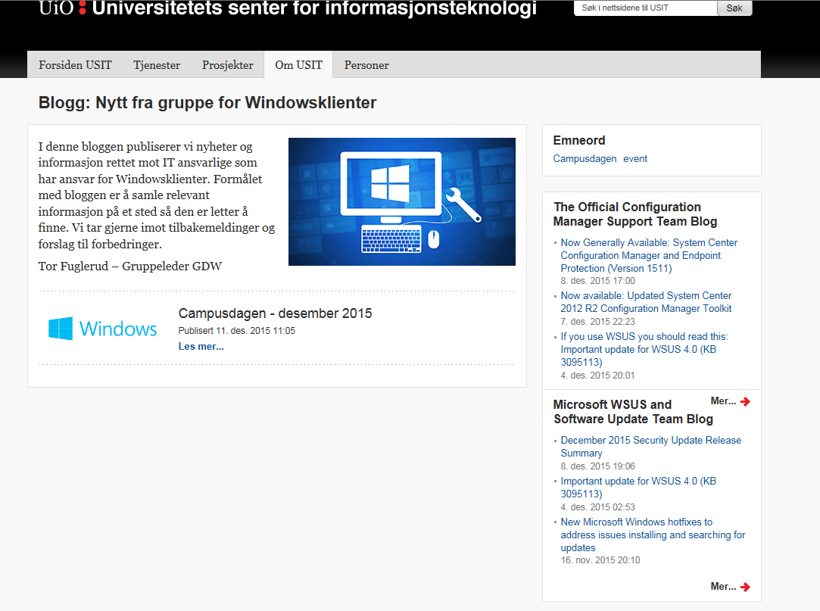
Besøk vår blogg
http://www.usit.uio.no/om/organisasjon/it-drift/kd/gdw/gdw-blogg/

Slide 3
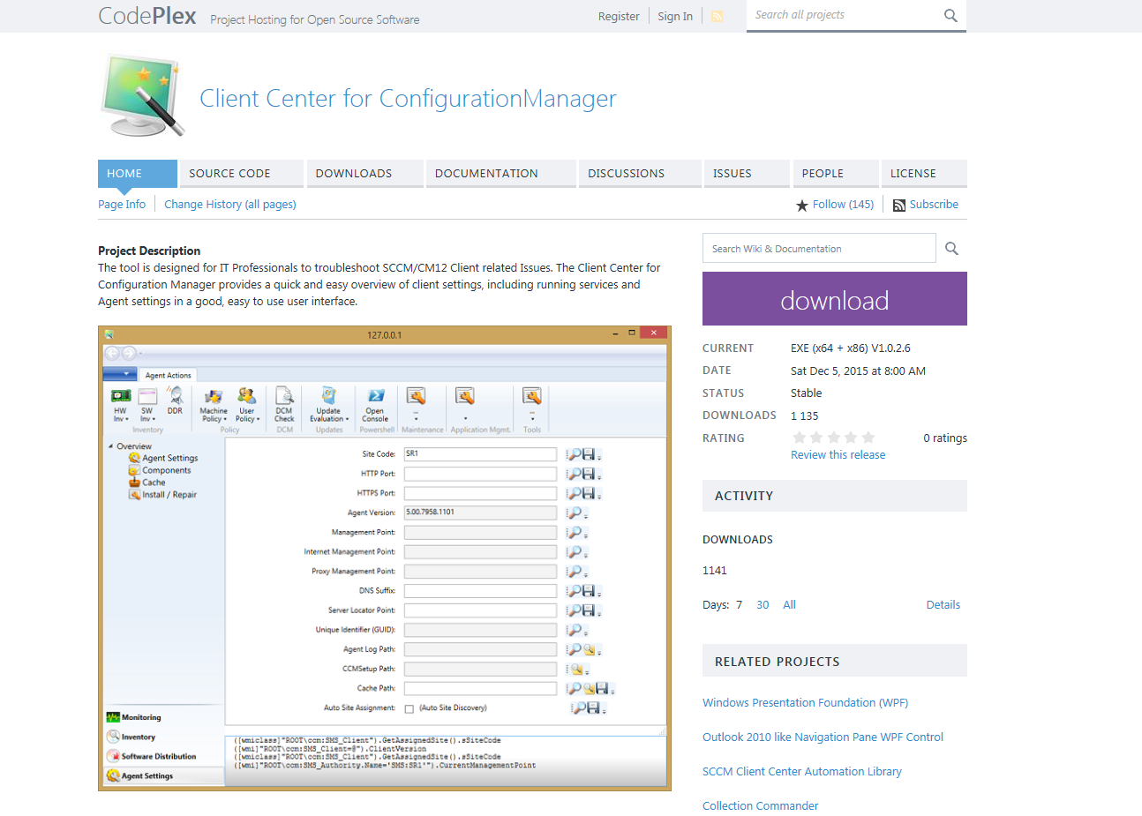
Remote Manage App
Community tool av Roger Zander
https://sccmclictr.codeplex.com/
Fjernstyring integrert med SCCM
Powershell
Alt-i-ett
Usynlig for brukeren
Notes:
Add or remove clients from device collections
Run Configuration Manager Client actions remotely
Interact with Applications, Packages in Software Center, and installed applications
Interact with Software Updates deployed from SCCM. Requires SUP to be enabled at the Configuration Manager site
Interact with processes, services, printers
Remote shutdown/reboot commands
View remote Computer Management, Event Viewer, and Users & Groups
Start RDP, Remote Control, or Remote Assistance sessions
Evaluate Group Policy results (RSoP)
Start WMI health validation & repair
WOL capabilities
View computer information compiled from Configuration Manager and the remote client

Slide 4
DEMO

