Slide 1
Software Distribution
Gunnar Horrigmø

Slide 2
Software Distribution, i gamle dar
App
Tivoli-måten
FEIL FEIL FEIL
Required
Required
man
push

Slide 3
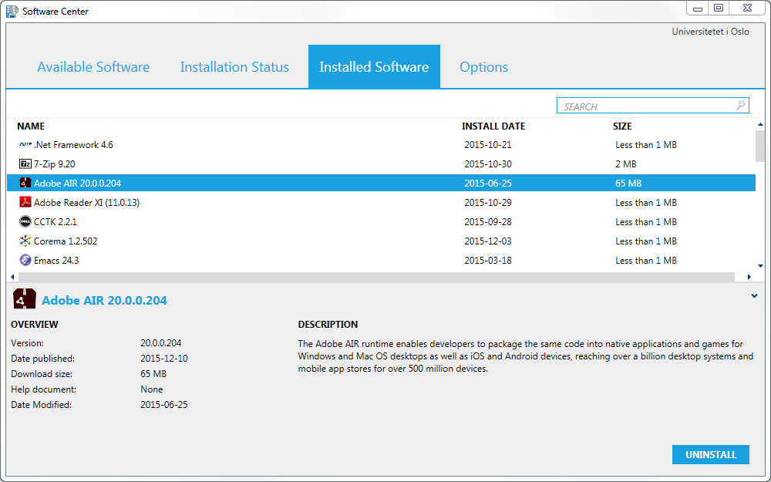
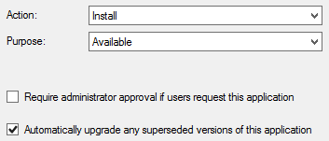
Software Distribution
App
Available
Required
alle
push

Slide 4
Software Distribution, spådom
Emacs
Required
Available
uio.dev.math.kontorfolk
All Clients
Push-
collections
Required
Available
LaTeX

Slide 5
Vedlikeholdsvinduer
Daglig 00:00 – 06:00
Ukentlig 00:00 – 06:00
Unntatt
Laptoper
Installert siste 36 timer

