Slide 1
TSD and Cerebrum
Gard Thomassen, PhD
Seksjonsleder, UAV/ITF, USIT

Slide 2
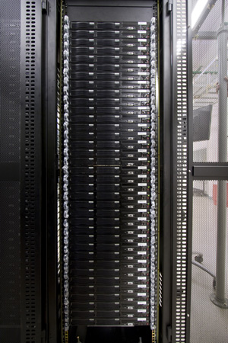
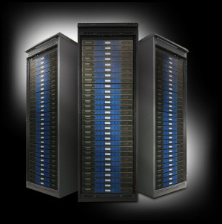
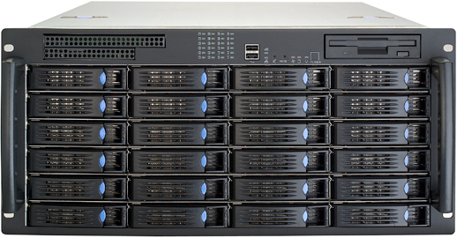
TSD in a nutshell
VM-server
HPC - Colossus
Gateway
n
1
Internet
Secure encrypted network
to special high volume
data production sites
1 (project)
1 (storage area)
Storage

Slide 3
TSD in numbers
# projects vs. time

Slide 4
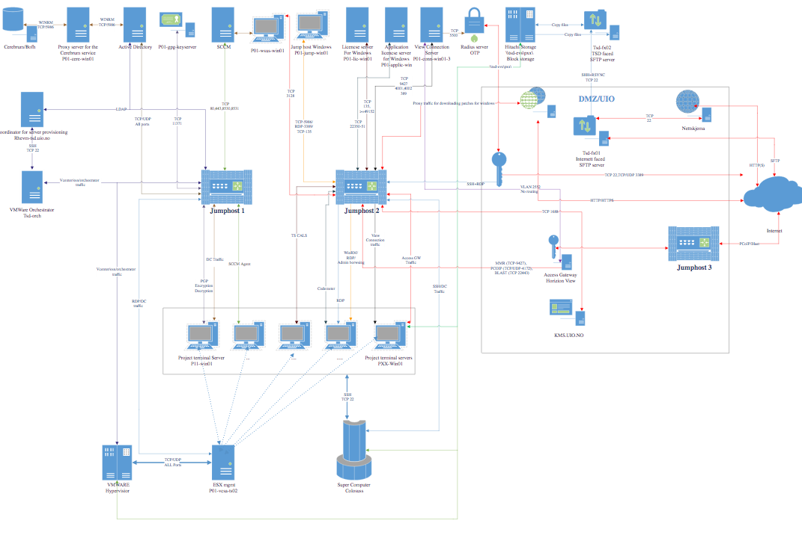
TSD: a “mini-USIT”

Slide 5
Cerebrum in TSD
Cerebrum is used to administer projects/persons/users/machines
Cerebrum has its own instance inside TSD (RHEL7)
Cerebrum/bofh talks with the TSD AD
Cerebrum/bofh is asimilar to the UiO Cerebrum as possible (most of the commands are the same)
Project-object has been adjusted to the TSD project management.

Slide 6
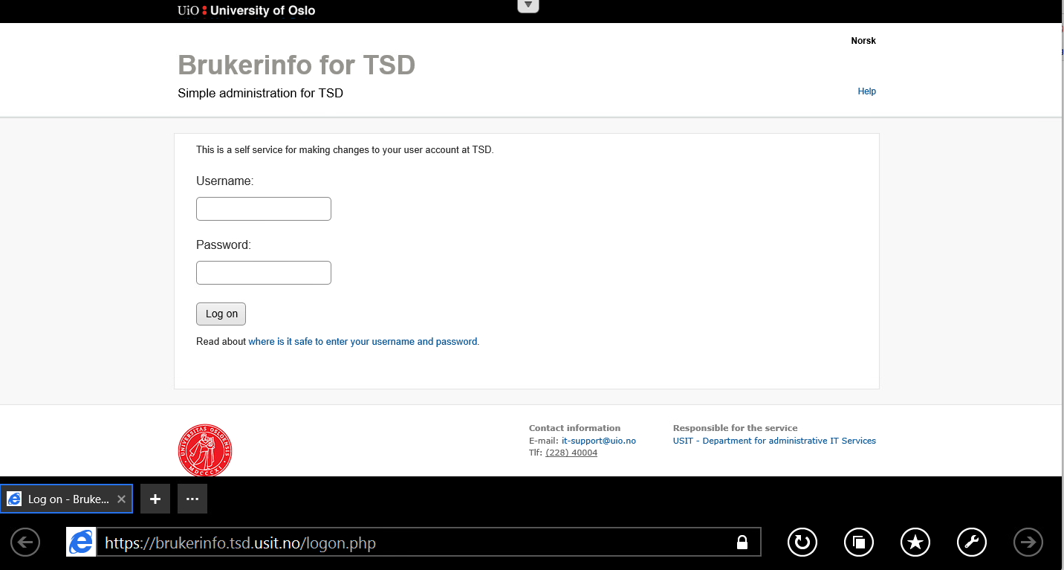
Brukerinfo in TSD
Used to change user password
Used by the project admin to administer users and users groups.

